Slide 1

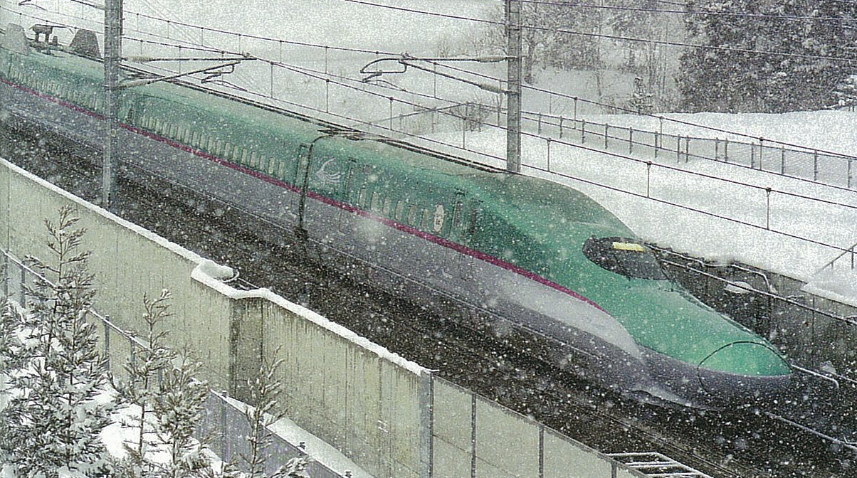
High Speed Rail in Japan - How to deliver utmost punctuality under heavy winter conditions -
Harutoshi HAYASAKA General Manager Technology Headquarters, Japan International Consultants for Transportation Co.,Ltd, JIC

Slide 2
Main Contents
> Introduction of JIC
> Short History of Railway
> Shinkansen Network
> Main Features of the Shinkansen
> Annual Average Delay Time in Tokaido Shinkansen
> Framework for Implementation of Shinkansen Project
> Procedure of Shinkansen Construction
> Percentage of Structures on Shinkansen
> Measures against Snowfall
> Basic Points for Measures against Snow Damage
> Measures against Snow Damage and Weather Conditions
> Location of Snow-melting Facilities
> Specification of Sprinkler System
> Kinds of Equipment on Measures against Snowfall
> Flow Chart of Sprinkler Spray
> Conclusions

Slide 3

Introduction of JIC

Slide 4
Short History of Railway
1825 Commencement of Railway Operation in England
1856 Commencement of Railway Operation in Sweden
(Malmö - Göteborg)
1870 Start of Railway construction in Japan
1872 Commencement of Railway Operation in Japan
(Shimbashi – Yokohama) 29km
1964 Commencement of Shinkansen Operation
(Tokyo –Shin-Osaka)
1987 Privatization of Japanese National Railways
2013 Operation of 320km/h with Series E-5 at Tohoku Shinkansen

Slide 5
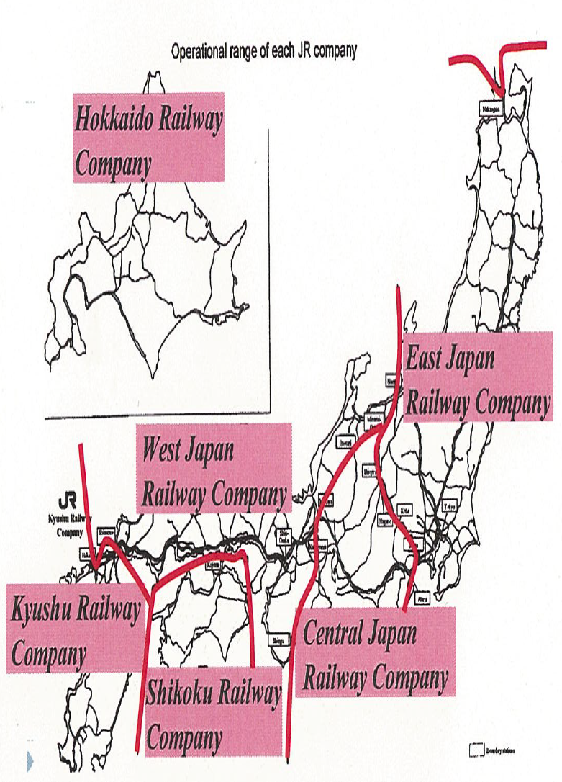
Operational Range of Each JR Company

Slide 6
Shinkansen Network
In operation
(2,388km)
( )
Constructed by JRTT
Sapporo
Under construction
(422km)
Hokkaido Shinkansen
Planning stage
(533km)
Shin-Hakodate
2016
Shin-Aomori
Akita
Sanyo Shinkansen
Hokuriku Shinkansen
Tohoku Shinkansen
Yamagata
Niigata
[ Nagasaki Route ]
Kanazawa
2015
Nagano
Hakata
Tokyo
Shin-Osaka
Joetsu Shinkansen
Kagoshima-Chuo
Kyushu Shinkansen
Tokaido Shinkansen
[ Kagoshima Route ]

Slide 7
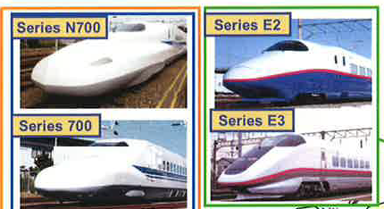
Shinkansen Vehicles

Slide 8
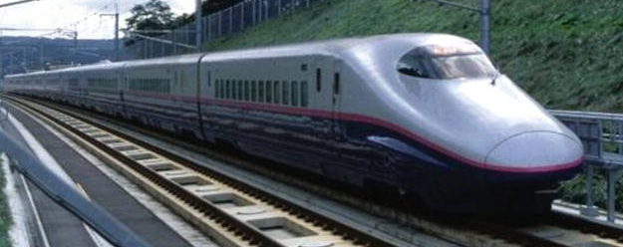
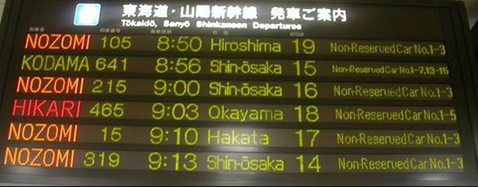
Safety
Main Features of the Shinkansen
No passenger fatalities in 49 years
Reliability
High Density
Average delay time
less than 1 min
Up to 15trains per hour
Mass Transit
Approx. 890,000 passengers
Per day

Slide 9
Annual Average Delay Time in Tokaido Shinkansen
Year
Annual Average Delay Time (minute/train)

Slide 10

Framework for Implementation of Shinkansen Project
□ Separation of infrastructure and operation
JRTT (Government Agency)
（Infrastructure construction and ownership）
Lease of
facilities
JR (Private Companies)
（Shinkansen operation）
□ Financing
National (2/3) and local (1/3) governments bear financing
burden for the Shinkansen infrastructure. (Public works)
National Government
Local Governments
67 %
33 %
JRTT : Japan Railway Construction, Transport and Technology Agency

Slide 11
Procedure of Shinkansen Construction
National government
JRTT
Operator (JR)
Minister of Land, Infrastructure, Transport and Tourism
Decision of basic plan
Directs to conduct study
Order
Conducts study
based on the plan
Environmental impact
assessment
Submits study report
Nomination of construction body
Nomination of operator
Construction body
(JRTT)
Nomination
Decision of provisional plan
Construction order
Draws up a
construction plan
Consultation
Application
Operator
(JR)
Approves the construction plan
Agreement
Approval
Start of
construction work
Lease
Completion
Operates

Slide 12
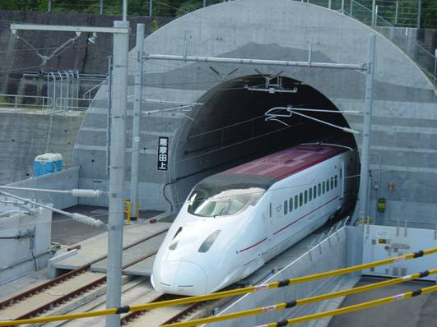
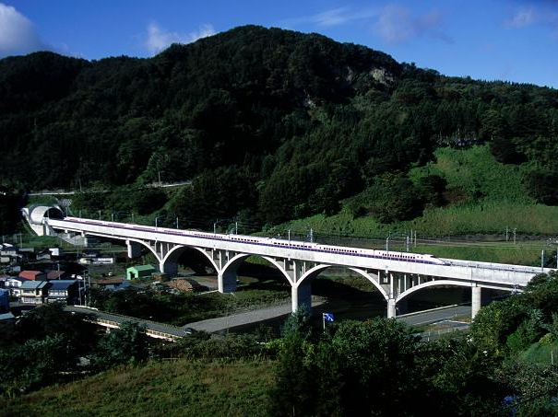
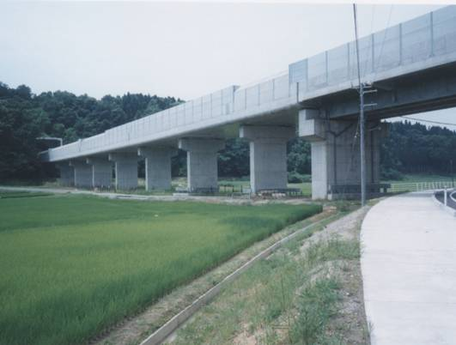
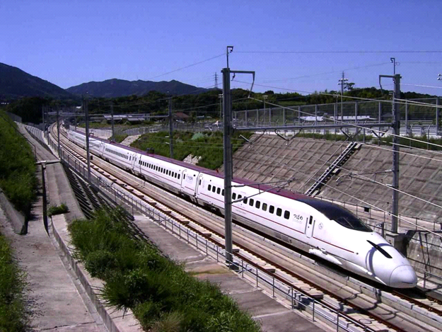
Bridge
Structures on Shinkansen
Tunnel
Viaduct
Earth Structure

Slide 13
Percentage of Structures on Shinkansen
Kyushu Shinkansen
(Shin Yatsushiro-
Kagoshima Chuo)
NEW
Tohoku Shinkansen
(Morioka-Hachinohe)
Hokuriku Shinkansen
Tunnel
(Takasaki-Nagano)
Bridge
Tohoku Shinkansen
(Tokyo-Morioka)
Viaduct
Joetsu Shinkansen
Earth
Structure
(Omiya-Niigata)
Sanyo Shinkansen
(Shin Osaka-Hakata)
Tokaido Shinkansen
OLD
(Tokyo-Shin Osaka)
0%
20%
40%
60%
80%
100%

Slide 14
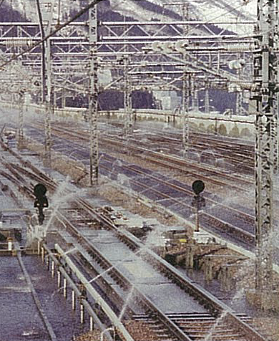
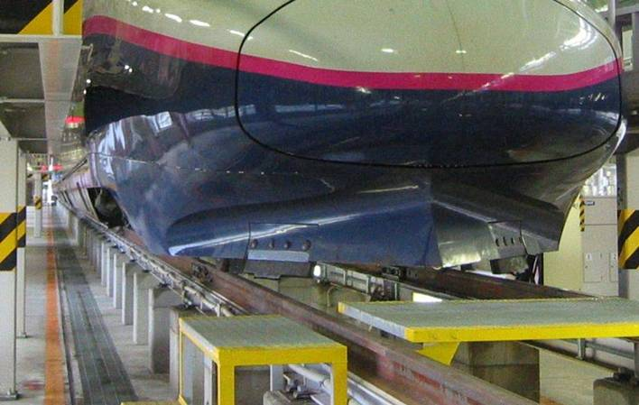
Measures against Snowfall
Snow disposal with vehicle
Sprinkling of water

Slide 15
Basic Points for Measures against Snow Damage
>Equipment for aiming at scheduled train operation against the maximum 10-year snow depth and the maximum daily snowfall.
>Snow plough of the train removes the snow on the track during commercial operation.

Slide 16
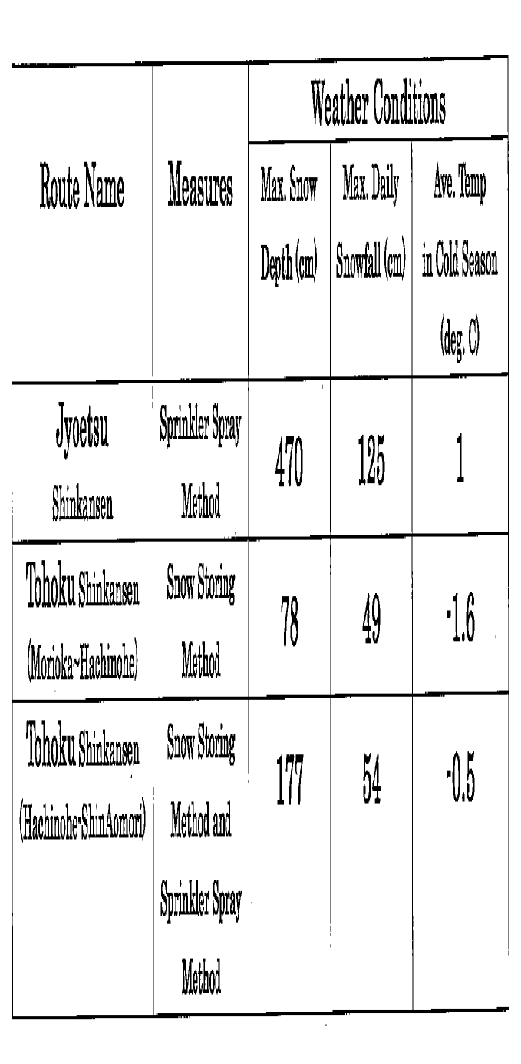
Measures against Snowfall and Weather Conditions

Slide 17
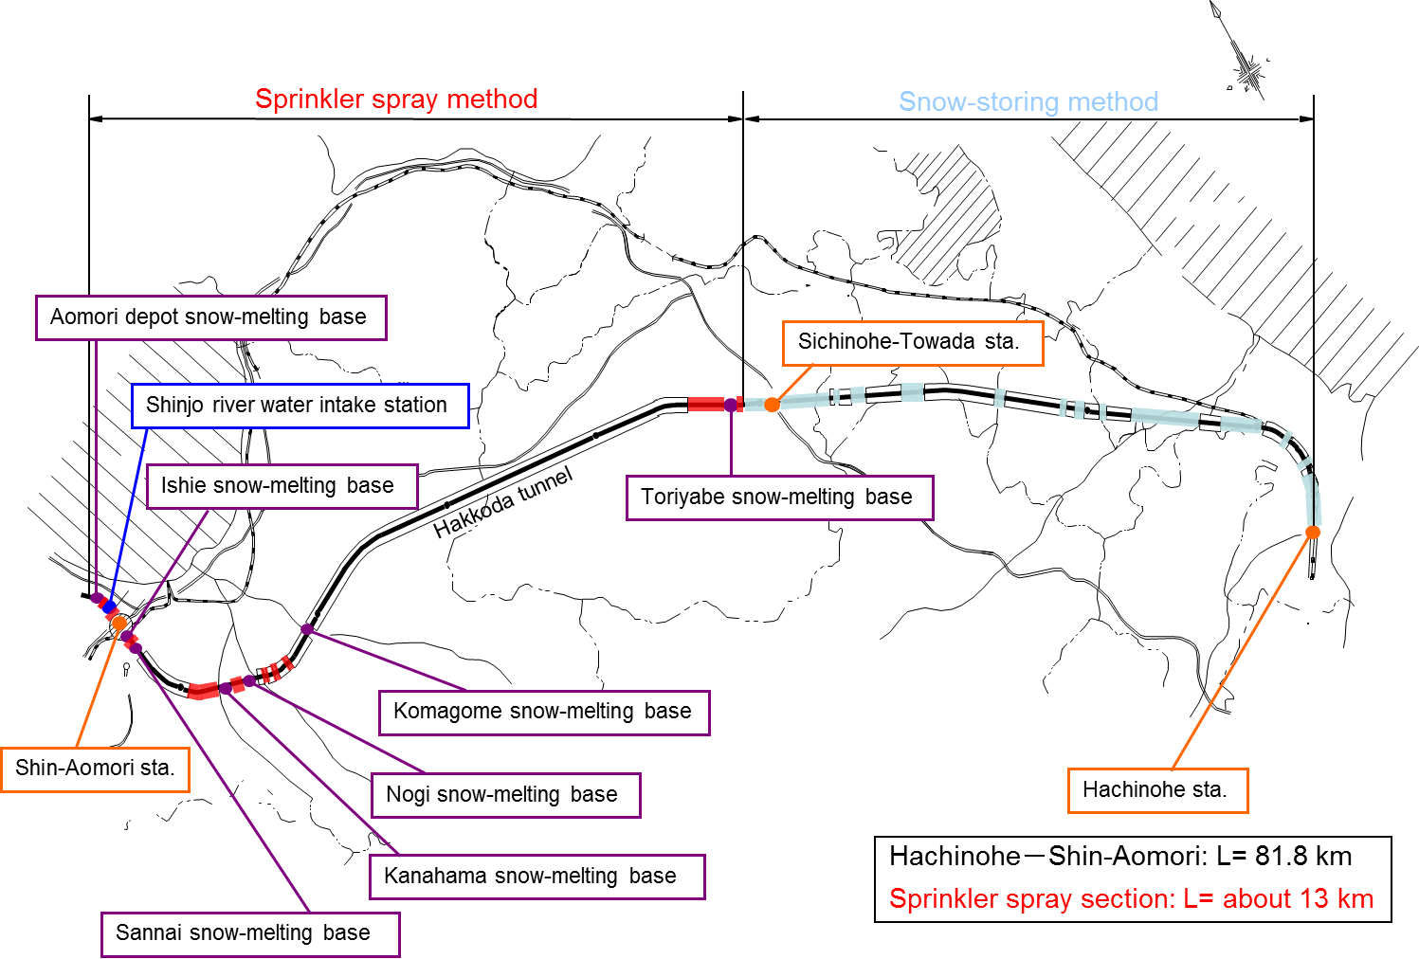
Location of Snow-coping Facilities

Slide 18
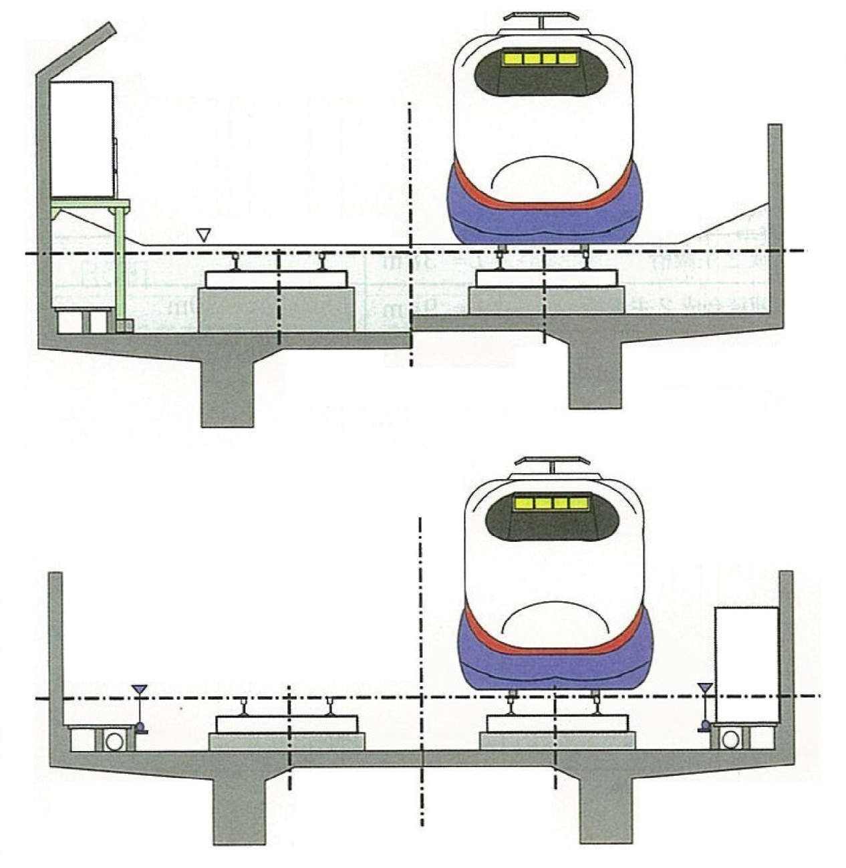
Measures against snowfall
Cross-section of snow-storing type
Standard snow-storing
Semi snow shelter
Snow disposal with sloping eaves
of soundproof wall
Maintenance passage
Snow-storing line
R.L.+0.10m
Change the storing volume by
the thickness of roadbed RC
Maintenance passage
Cross-section of sprinkler spray type
Sprinkler

Slide 19
Snow-melting Formula
The formula consists of 5 heat quantities :
1 Quantity of Radiation Balance : Q _{R}
2. Quantity of Conductive Heat at Slab: Q _{C}
3. Expended Heat Quantity by Watering: Q _{H}
4. Heat Quantity for Snow-melting : Q _{IS}
5. Quantity of Turbulence Transmittable Heat : Q _{AE}
Q _{H} + Q _{R} + Q _{C} + Q _{AE} = Q _{IS} --------------(a)
Q _{AE} = Q _{IS} － Q _{H} － Q _{R} － Q _{C}

Slide 20
Presumption of Heat Balance
Q _{AE} = Q _{IS} － Q _{H} － Q _{R} － Q _{C}
Q_{AE} : Turbulent Heat Transfer
Q_{R} : Quantity of
Radiation Balance
Q_{H} : Expended Heat by Watering
Q_{IS} : Heat for Snow-melting
Slab Surface
Q_{C} : Conductive Heat of Slab

Slide 21
Specification of Sprinkler System
Amount of water sprinkling | 1.0 liters / min. /m²
Designed water temperature | 10.6 ℃ ～ 11.8 ℃
Method | Circulation of heated water
Water source | Water inflow from tunnel and a river water
Interval between sprinklers | 6 m (staggered layout)

Slide 22
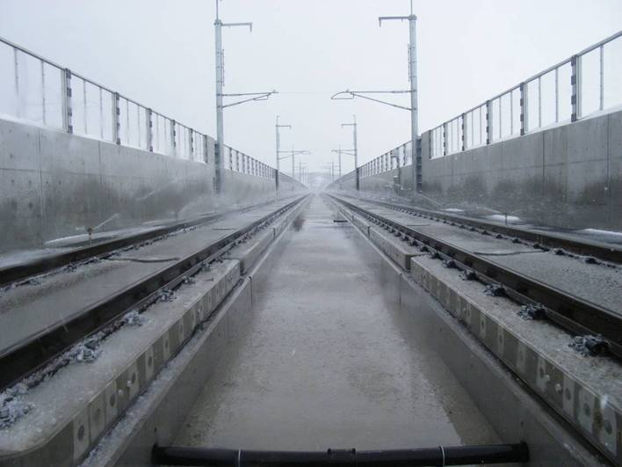
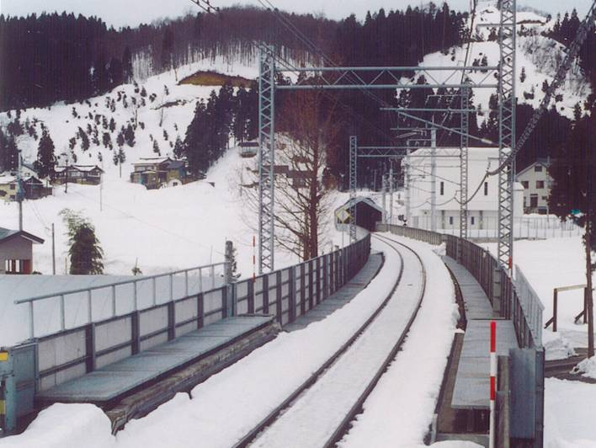
Measures against Snow and Ice
In case of heavy snowfall
Sprinkling of water
Snow melting
（ Tohoku Shinkansen ）
（ Conventional line ）

Slide 23
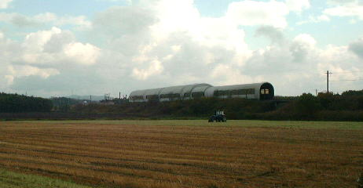
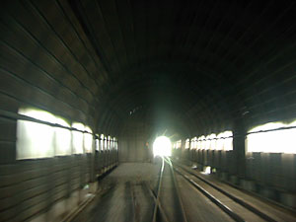
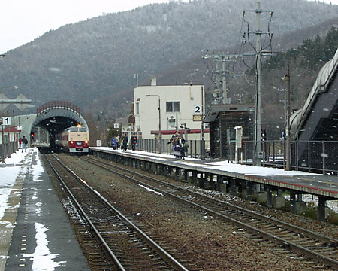
Snow Shelter
Upper left : Over view of snow shelter in conventional line
Lower left : inside view of snow
shelter over the turnouts
Lower right : Front view of snow
shelter over the turnout in station
Snow Shelter over the turnouts at conventional line

Slide 24
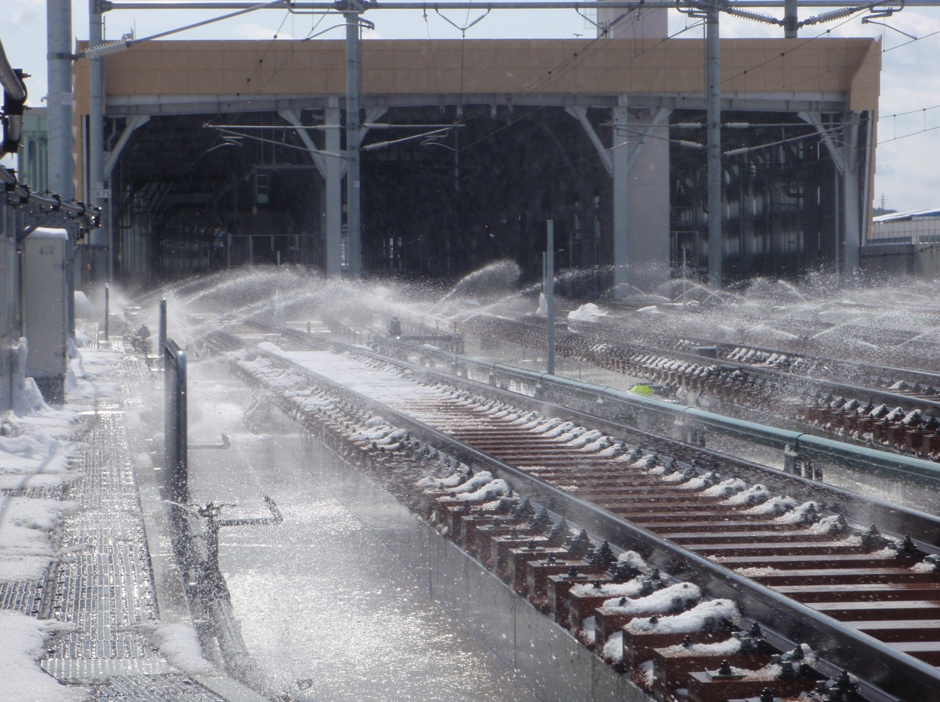
Snow-melting with Sprinkler Spray

Slide 25
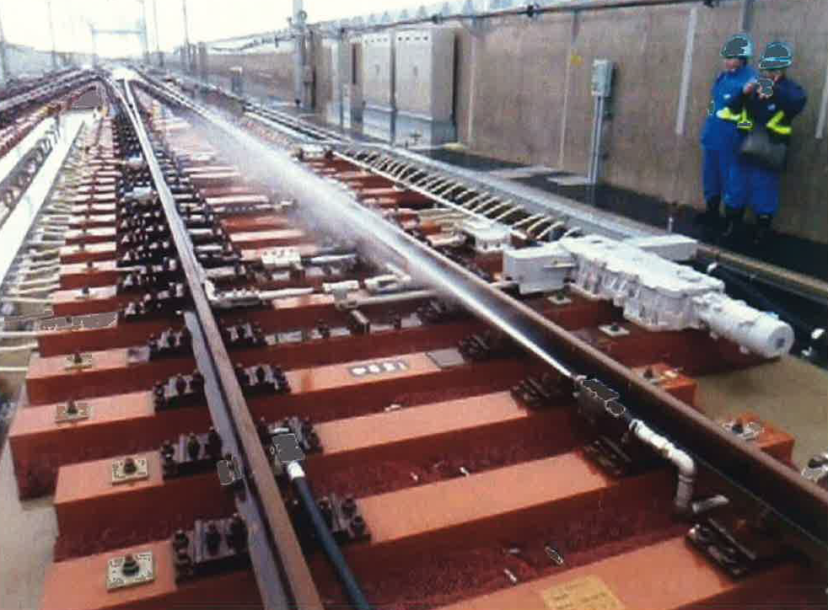
Snow Removal with Heated Water Jet at Tongue Rail of Scissors Crossing

Slide 26
Kinds of Equipment on Measures against Snowfall
Snow Protection Equipment
Snow Shelter
Snow Jet
Water Intake Base
Snow melting Equipment
Snow Melting Equipment with Watering
Equipment at Snow Melting Base
Far Monitoring Equipment
Equipment of Measures Against Snow Damage
Equipment of Measures Against Snow Damage at Turnout
Heated Water Jet
Floor Slab Heating Type
Snow Melting Equipment with Heated Water
Pocket type Snow Storage
Snow Storage Equipment
Semi-snow Shed Type Snow Storage
Snow Storage
Open Floor type Viaduct

Slide 27
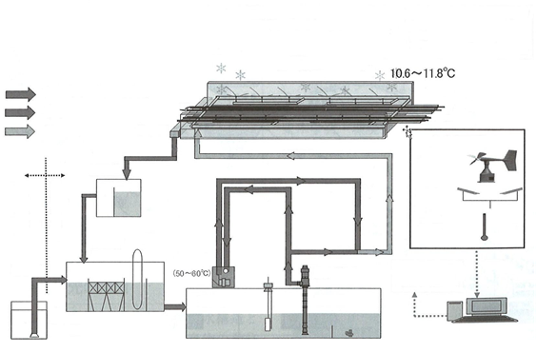
Flow Chart of Sprinkler Spray
※ Condition for starting water sprinkling
Snow fall of more than 0.25cm/h continues for more than 20 min.
or
Snow fall of more than 0.50cm/h continues for more than 10 min.
※ Condition for stopping water sprinkling
No snow fall continues for more than 10 min.
and
Returned water temperature is more than 2℃.
Snow-melting by
sprinkler spray
ｓｐｒａｙ
Heated water (50～60℃)
Cold water
Rail
Snow-melting water
Catchment point
To viaduct
Wind
velocity
Circulating tank
Water intake
station
Snow-melting base
Detection
Temperature
Dust removing tank
Conduit
Heater
Water pump
・Start / Stop
Water temperature
Data
Settling tank
Control PC
Water intake tank
Water storage tank
Heat storage tank

Slide 28
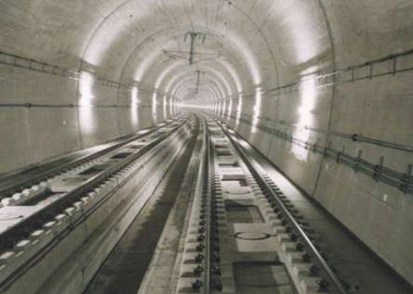
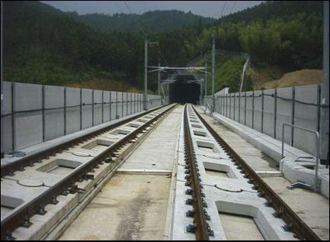
Track Structure（Slab Track）
Tunnel
Bridge
（ Kyushu Shinkansen ）
（ Kyushu Shinkansen ）

Slide 29
Conclusions
Points of view for selecting High Speed Rail structures:
Selection from a viewpoint of LCC including maintenance cost
Reduction of maintenance cost by adopting slab track in the section of cut and embankment.
Application of asset management by adopting concrete structures such as viaduct and tunnel.
Points of view for utilizing characteristics as high-speed rail:
To secure promptness as exclusive line for passengers
No adoption of surface crossing
Point of view on measures against snow damage in winter for securing punctuality of train operation :
Selection of equipment for measures against snow damage (such as snow storing type, sprinkler spray method, snow shelter,open floor type viaduct)

Slide 30
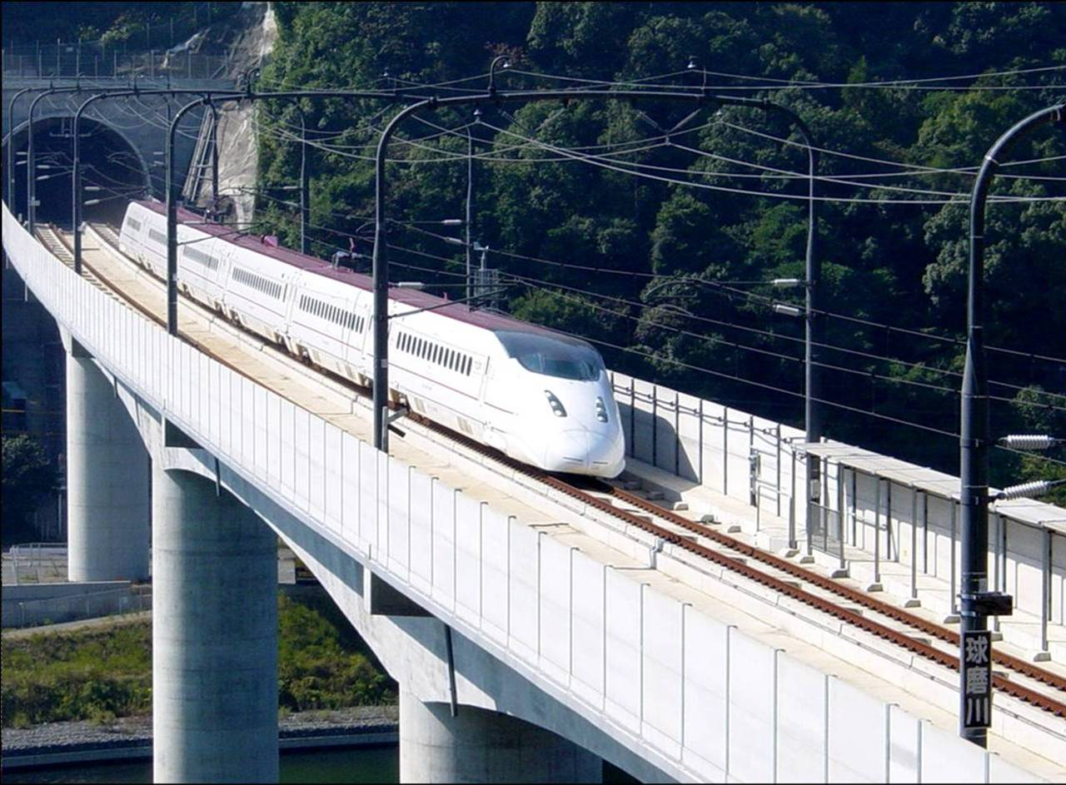
Thank you for your attention.

