Slide 1
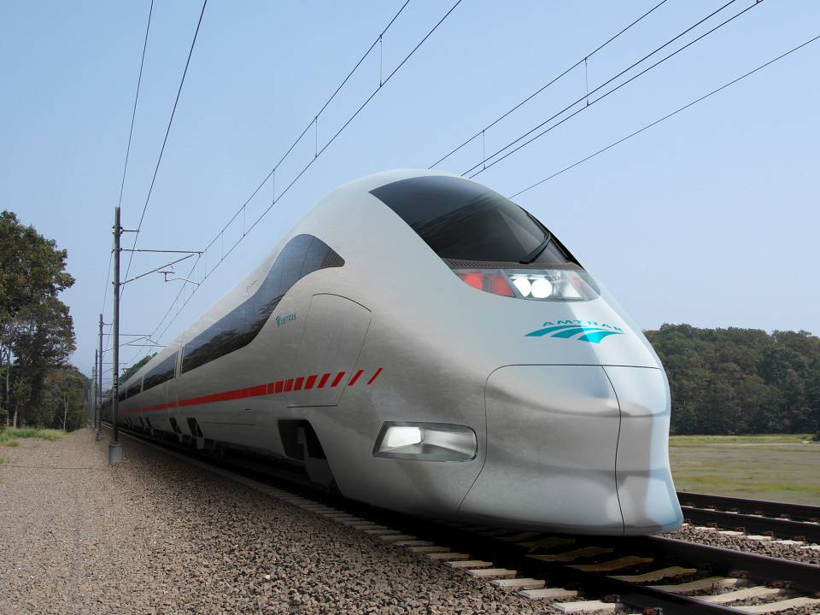
The Northeast Corridor Vision
for High Speed Rail
How to build High Speed Rail (HSR) in Scandinavia
Andrew M. Wood Chief, Next Generation Integration, HSR,
NEC Infrastructure and Investment Development Amtrak
10th April 2013
1
Notes:
1

Slide 2
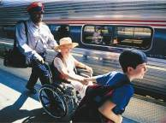



The Amtrak System
Congressionally-chartered National Railroad
20,000 employees operate a 21,100 mile system
310 daily intercity trains; 528 stations
70% of our train-miles run on track owned by other railroads
Set ridership (31.2M) and ticket revenue ($2.0B) records in FY 2012
FY 2012 Federal funding for Amtrak was $1.418 billion:
466 million for operating expenses
952 million for capital needs
FY 2013 Federal funding request for Amtrak is $2.2 billion
FY 2014 Federal funding request for Amtrak is $2.065 billion

Slide 3
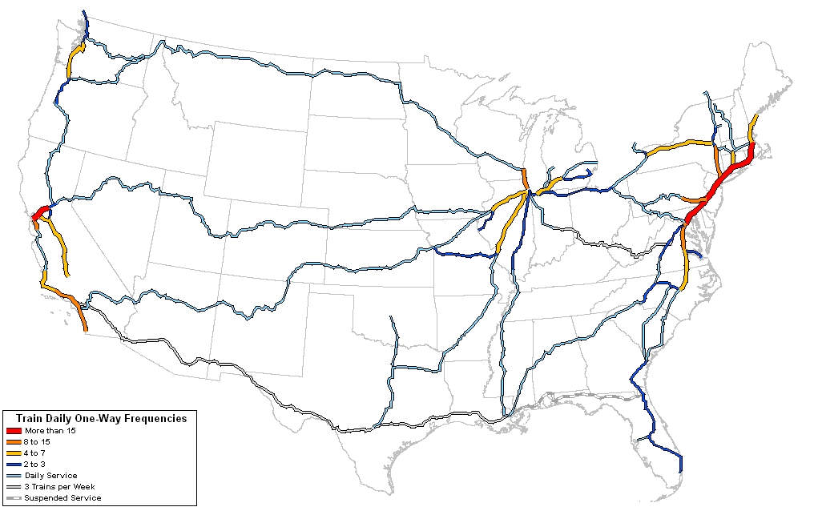
The Amtrak Network
Cascades
Long distance routes
connect major hubs
and corridor services
Chicago Hub
California
corridors
Northeast
Corridor

Slide 4
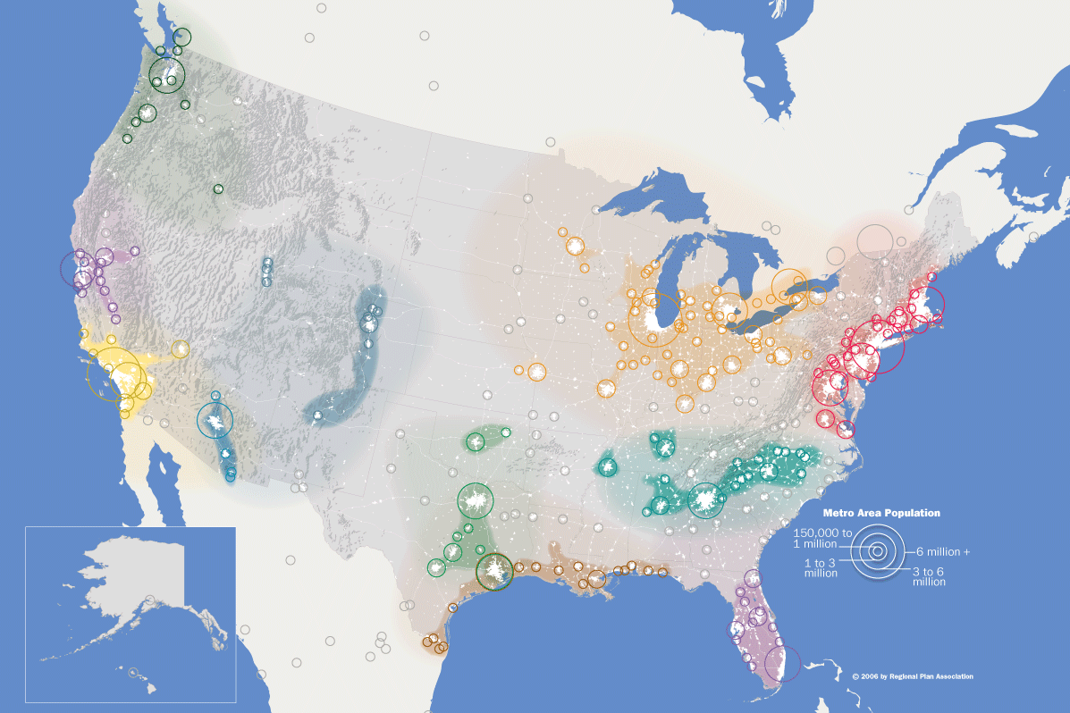

America’s Megaregions
Cascadia
Northern California
Southern California
Front Range
Great Lakes
Northeast
Sun Corridor
Piedmont Atlantic
Texas Triangle
Gulf Coast
Florida
Notes:
4
Megaregions are networks of metropolitan areas, connected by:
Overlapping commuting patterns
Business travel
Large infrastructure networks, such as rail corridors and electricity grids
Environmental systems and topography
Share history and culture
As a planning concept they provide a basis for thinking about large systems that cross political boundaries. They also intersect nicely with the scale at which high-speed rail is most competitive with autos and air travel.
In the U.S., over 70 percent of the population and jobs are located in these 11 megaregions identified by the national planning think tank, America 2050.

Slide 5
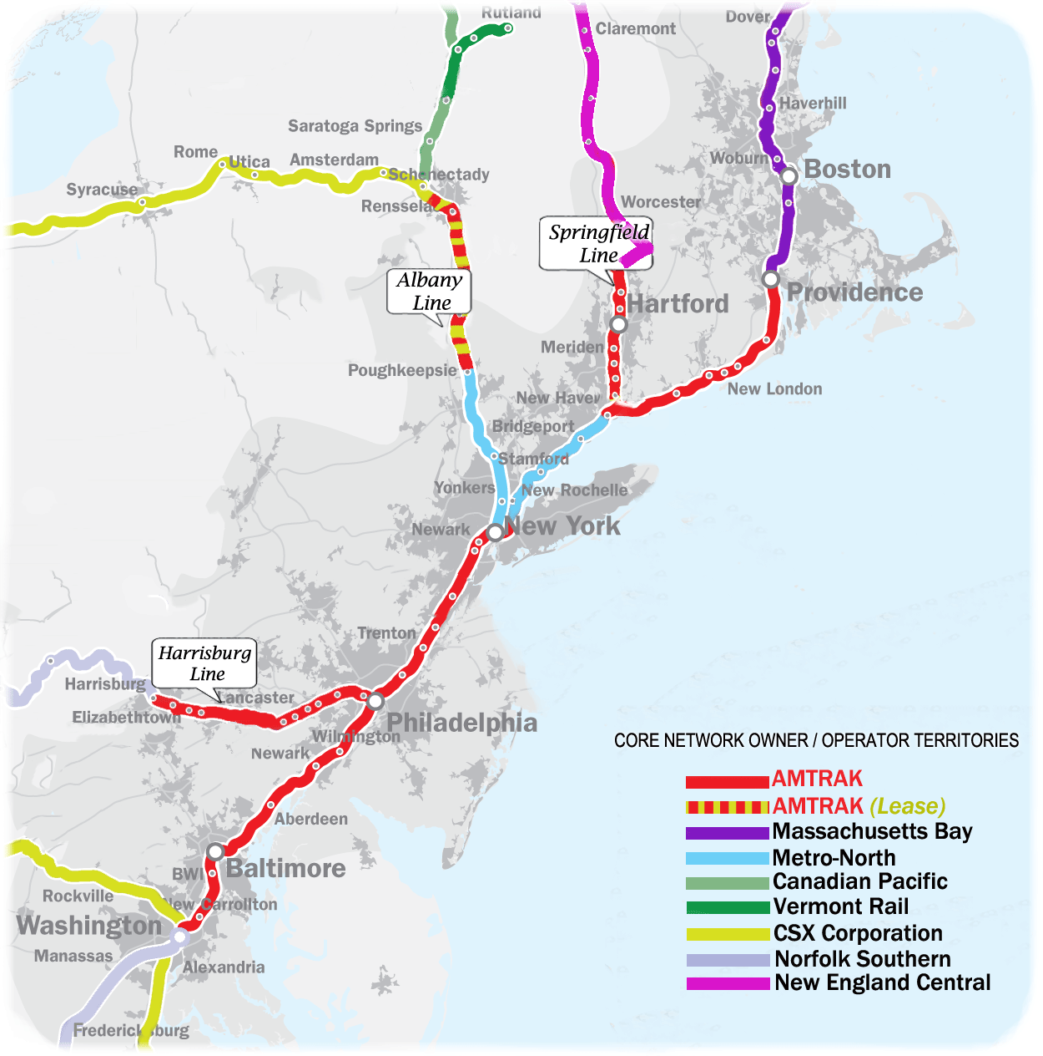
The Northeast Corridor Mainline and Branches
899 Route-miles
546 Miles Amtrak-owned
66% electrified
8 commuter operators
Freight Service
2,200 daily train movements
Amtrak Acela Express, Regional, State-supported & Long-Distance

Slide 6
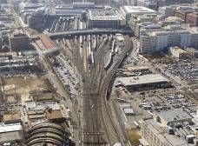
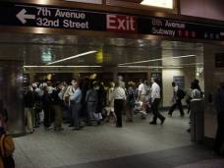
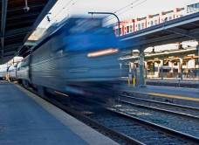
Northeast Corridor - Complex Operations
153 of Amtrak’s 305 daily trains, plus more than 1,800 daily commuter trains
Approximately 750,000 riders every day (Amtrak plus commuters)
Approximately 75 freight trains per day
Amtrak owns and maintains 363 of the 457 route-miles
17 tunnels (six underwater tunnels to access Manhattan)
1,186 bridges (14 of them moveable)
Top speeds of 150 mph for Acela Express and 125 mph for Northeast Regionals

Slide 7
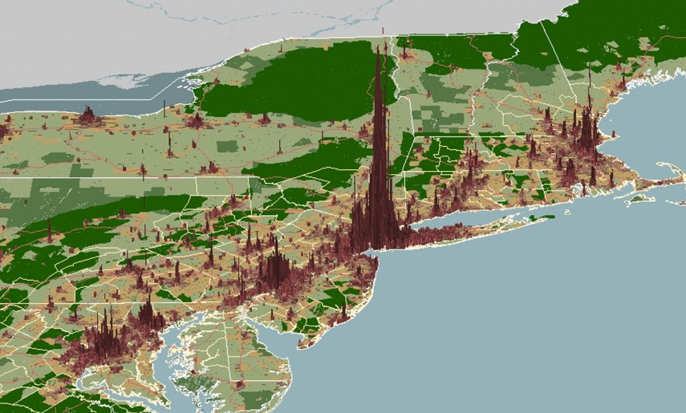
Population Density in the Northeast Corridor
Image: Regional Plan Association
Notes:
This is a map of population density projected three-dimensionally. The Northeast Megaregion concentrates more people in its center cities and central business districts than anywhere in the country. These major business centers – Boston, New York, Philly, Baltimore, DC, also happen to be connected along the Northeast Corridor, providing a level of travel redundancy to airports and highway movement not found anywhere else in the United States.
You are also looking at a picture of the Northeast’s competitive advantage, vis a vis other economic centers in the U.S. These CBDs concentrate the largest shares of knowledge sector jobs in the country.These jobs, which require face-to-face communication tend to be high value and the types of jobs that cannot be outsourced. Thus one of the Northeast’s key selling points is its concentration of highly skilled labor and knowledge jobs in its central business districts, which could only be possible with the type of rail transportation that is offered in the Northeast.
The Northeast is a powerhouse of density and economic output:
17% of the nation’s population
2% of the land area
producing 20% of U.S. GDP
Population growth: ~15 million additional residents by 2040-50
Intercity travel growth: 45% to 75% increase by 2040-50
Growth will demand infrastructure investments to support economic growth and preserve quality of life in Northeast
The economic competitiveness of the Northeast and the US is at stake
7

Slide 8
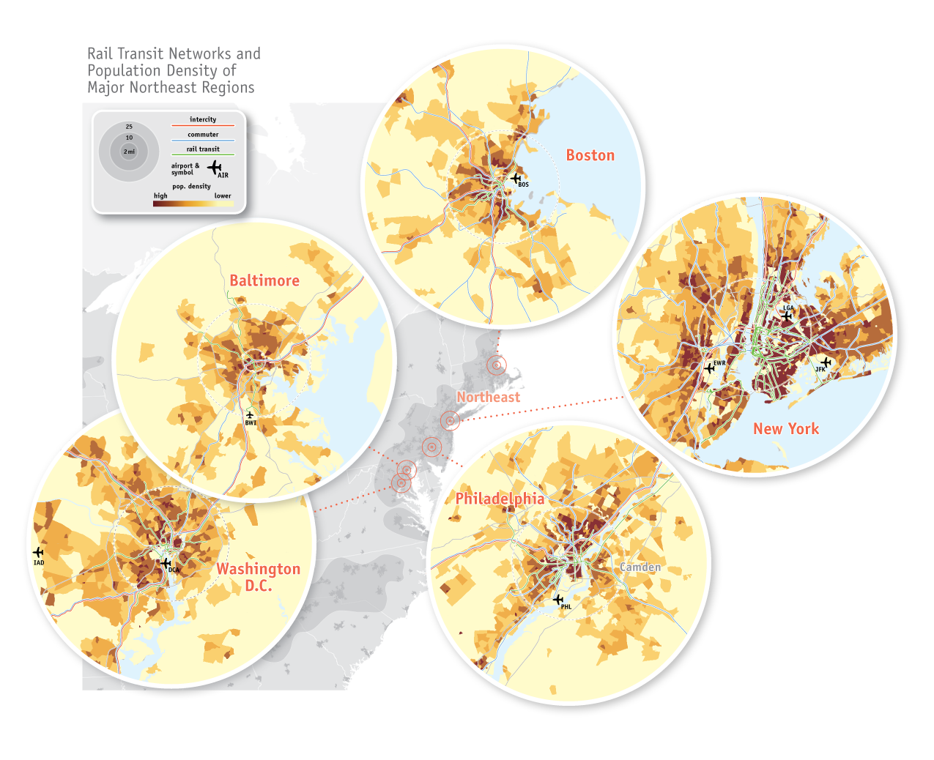
The Northeast Corridor: Uniquely Connected to Rail Transit Networks
Source: America 2050, High-Speed Rail in America, 2011.
Notes:
The Northeast Megaregion has the highest concentrations of rail transit ridership in the nation and the greatest accessibility to transit by its population and jobs.

Slide 9
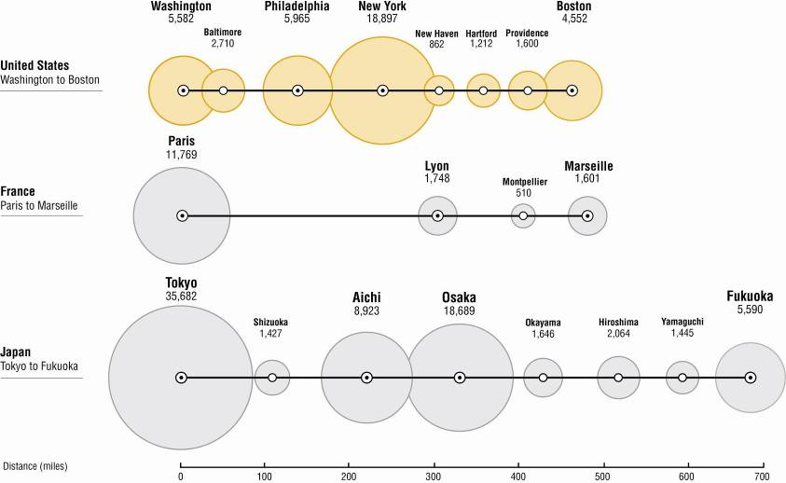
NEC Markets Compare Favorably to Successful HSR Corridors
Population Distribution by Metropolitan Area

Slide 10
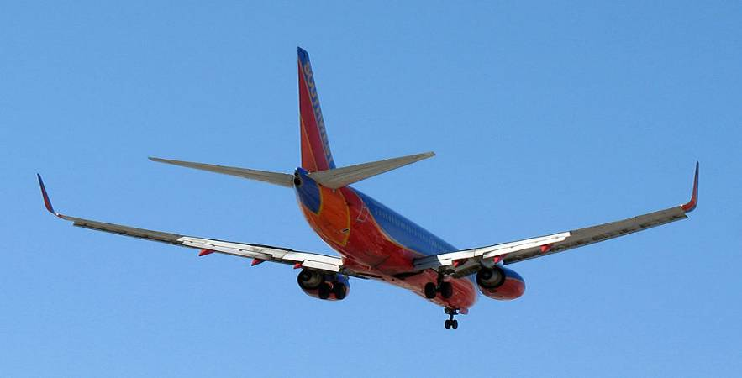
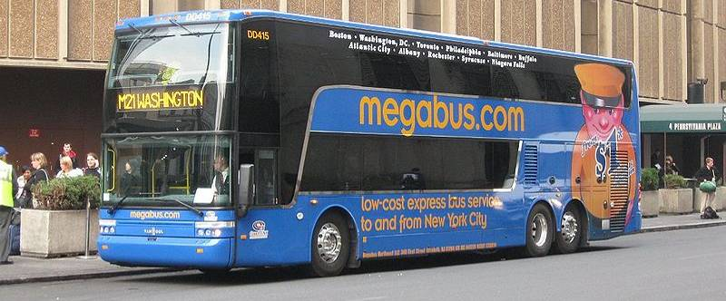
Other Modes Can’t Handle Entire Increase in Demand
Airlines
New York area airports account for half of U.S. flight delays
Carriers are reducing service within NEC to focus on more profitable longer flights
Highways
18 of the 40 “most congested” highway segments are between Washington and Boston
Buses
Limited appeal for business travel (lengthy and variable trip times)
Curbside buses exacerbate center city traffic congestion
Source: Alan Ferguson, “Approaching Lindbergh Field”
Source: Wikimedia Commons, Megabus NYC NY Penn Station stop
Notes:
10
For the airline statement - “In the first half of 2011, the region’s airspace — defined as the big three airports, plus Teterboro Airport in New Jersey, which caters to corporate jets, and Philadelphia International Airport — handled 12 percent of all domestic flights but accounted for nearly half of all delays in the nation… One study, by the Senate Joint Economic Committee, concluded that huge delays in 2007, which affected 320 million passengers, cost the economy $41 billion that year. That figure includes losses to the airlines, wasted time for passengers and the overall cost to the economy.”
Highway numbers come from the Texas Transportation Institute’s 2011 Congested Corridors Report.

Slide 11
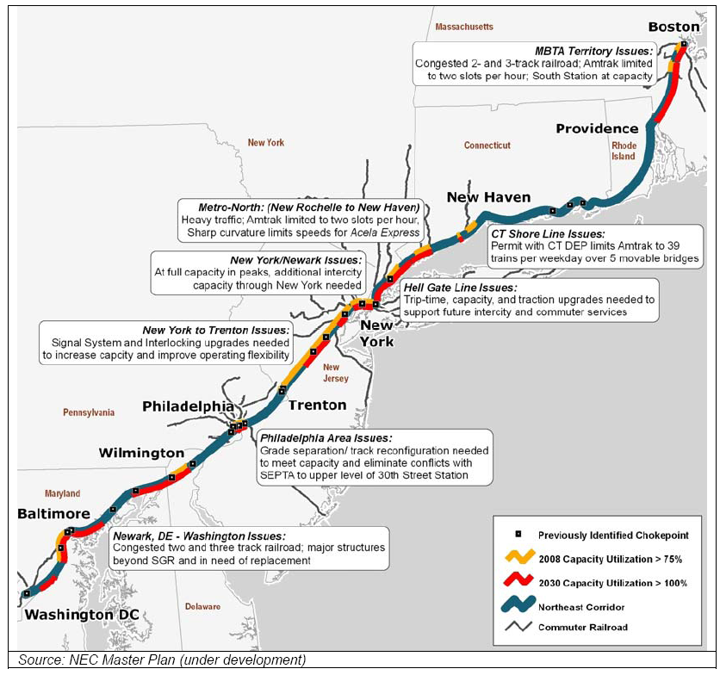
But the NEC Faces Capacity Constraints and Deferred Investments
2030 Forecasts
Train miles: + 37%
Intercity & commuter riders: + 60%
Investment needs by 2030:
SGR Backlog: 7.9 B
SGR Replace: $9.1 B
Core Growth: $32.9 B
Baltimore Tunnel: $2.0 B
Total: $51.9 B
Average of $2.6 B annually
Modest increase in capacity
Segment capacities along NEC exceeded by 2030
Previously Identified Chokepoint
2008 Capacity Utilization > 75%
2030 Capacity Utilization > 100%
Northeast Corridor
Commuter Railroad
Source: NEC Master Plan.
Notes:
11

Slide 12
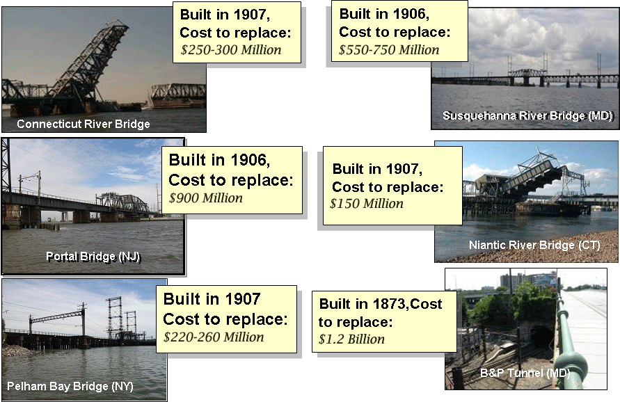
Centenarian Hall of Fame
B&P Tunnel (MD)
Pelham Bay Bridge (NY)
Notes:
12
Renewal and replacement of the bridges and tunnels on the NEC are the biggest infrastructure issue.
Many of the major bridges are functionally obsolete, have restrictions on speed and loading, and need replacement after over 100 years in heavy service
The tunnel in Baltimore, nearly 140 years old, is in such poor condition, that trains are restricted to under 30 mph. As the only route through the city, it cannot be taken out of service for more than superficial emergency repairs.
The operating restrictions on these links constrain Amtrak’s ability to shorten run times on a major portion of the corridor.

Slide 13
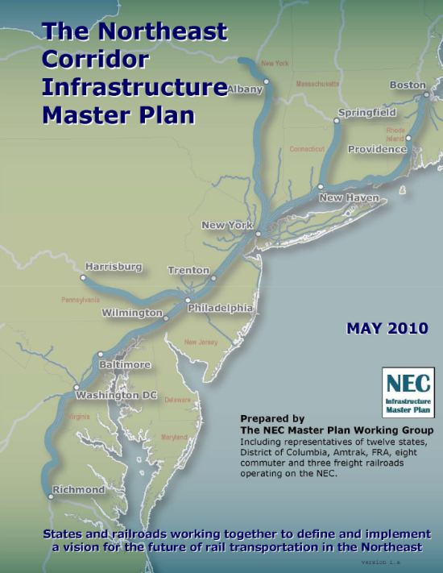
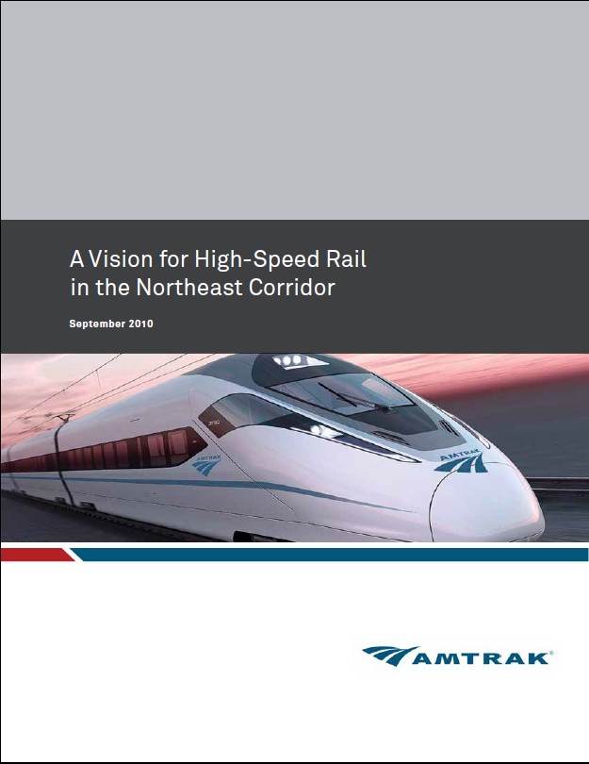
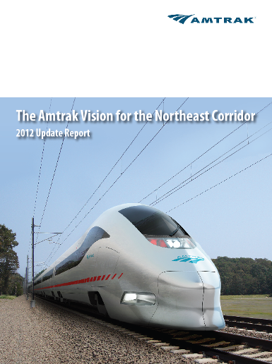
Status of NEC Planning Efforts for Growth
These plans are now inputs into the FRA-led “NEC FUTURE” process
Advancing Major NEC improvements require pursuing two simultaneous paths:
Incremental NEC Improvements permissible under 1978 PEIS
Major improvements - “NEC FUTURE” program
2010
2010
2012
Notes:
Since 2010, Amtrak has issued three major NEC Planning Reports:
2010 NEC Master Plan – Upgrade of the Existing Northeast Corridor by the NEC Master Plan Working Group
2010 NEC High Speed Rail Vision – Next-Generation High Speed Rail
2012 Vision for the NEC – Combined program of NEC Master Plan upgrades and Next HSR development
These plans are now inputs into the FRA-led “NEC FUTURE” process
Advancing Major NEC improvements require pursuing two simultaneous paths:
Incremental NEC Improvements that improve current services are permissible under the current Federal 1978, “Tier I” Programmatic Environmental Impact Statement (PEIS)
Major improvements that meaningfully change service levels and capacity require new “Tier I” environmental approval through “NEC FUTURE” program
Mitch will speak about the NEC Future program, so no need to go into detail.

Slide 14
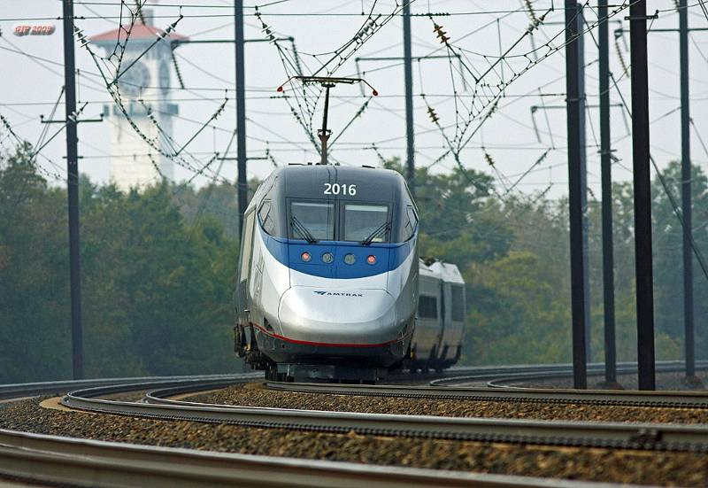
Amtrak’s Program for NEC Improvement and Expansion
Two progressive and overlapping programs:
NEC Upgrade Program (“Stairstep Plan”) - Advance projects under current PEIS that improve HSR and other services:
Create additional capacity
Raise top speeds and reduce trip times
Increase Trans-Hudson capacity
Achieve a State of Good Repair and Master Plan improvements
Notes:
14
Our overall strategy for the NEC is a series of overlapping programs.
Our first step will be the NEC-UP; that will bring the corridor to a state of good repair and add some limited capacity improvements while preparing for the Next-Gen to follow.
Some elements of Next-Gen will be built in parallel with the upgrade program so as to optimize the investment.
For example, where feasible without major property acquisition, the right of way may be prepared to accommodate the future Next-Gen tracks, or sections of the Next-Gen structures may be built as part of the NEC-UP.
14

Slide 15
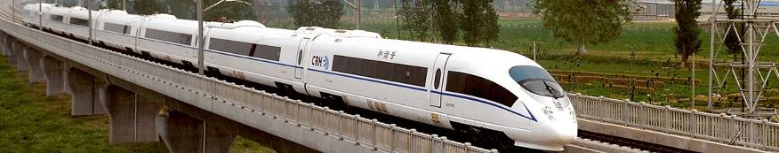
Amtrak’s Program for NEC Improvement and Expansion
Next Generation High-Speed Rail Program (“NextGen HSR”) – Develop and advance NextGen HSR services as part of an integrated NEC network:
Phased implementation of new, mostly dedicated two-track alignment for high-capacity, high-speed services
Separate high speed trains from regional and commuter trains, creating additional capacity for all services and improved reliability and efficiency
New station development
Integration with existing network to maximize network growth
Notes:
15
Our overall strategy for the NEC is a series of overlapping programs.
Our first step will be the NEC-UP; that will bring the corridor to a state of good repair and add some limited capacity improvements while preparing for the Next-Gen to follow.
Some elements of Next-Gen will be built in parallel with the upgrade program so as to optimize the investment.
For example, where feasible without major property acquisition, the right of way may be prepared to accommodate the future Next-Gen tracks, or sections of the Next-Gen structures may be built as part of the NEC-UP.
15

Slide 16





Implementation Phasing Strategy
NextGen HSR: NYC to BOS
NextGen
HSR
(2025-2040)
NextGen HSR: NYC to WAS
NEC 160 mph MAS: NYC to WAS
NEC Gateway: Newark to NYC
NEC-UP
(Upgrade Program)
(2015-2025)
High Speed Equipment Purchase
NJ High Speed Improvement Program
Notes:
Amtrak “Stair Step” Plan combines Master Plan and Vision into an comprehensive, integrated program
Addresses state of good repair, improves reliability and expands capacity for all users
Addresses most critical chokepoints on current NEC including expansion of capacity in New York under proposed “Gateway” program
Provides inter-operability between existing and proposed new alignment
Facilitates phase-in of NextGen HSR services through 2040
Additional ridership generates net revenues that potentially can be used to help finance NextGen construction
16

Slide 17
Advancing a Bold Future - NEC NextGen HSR
Augment the existing NEC with a new high-capacity, high-speed rail system:
Dedicated 2 - track alignment;
220 mph top speeds
up to 12 HSR trains an hour per direction
40% - 60% travel-time reductions in key markets
Sufficient growth capacity for the century ahead:
Allow HSR to carry larger portion of Northeast’s intercity travel market
Radically improve trip times and frequencies:
Reshape geography, induces demand, and create economic gains for the whole region
Shift high speed trains to mostly dedicated infrastructure:
Create additional capacity on the existing NEC and improve reliability and performance for all users.

Slide 18
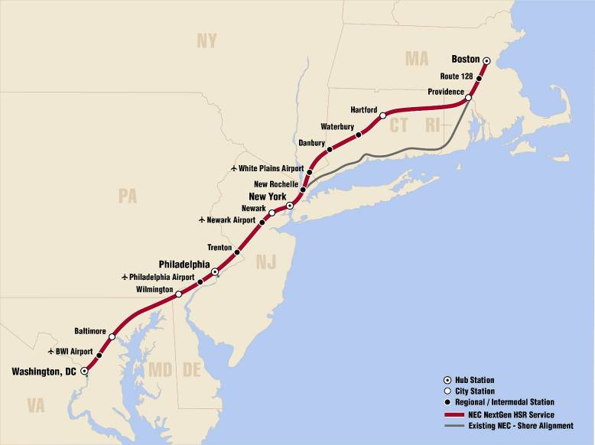
NEC NextGen HSR - Updated Conceptual Alignment

Slide 19
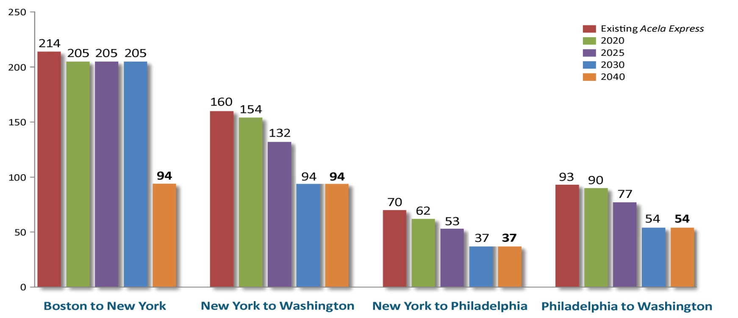
NEC NextGen HSR – Updated Travel Times
Early improvements in the existing NEC from 2015 thru 2025 would provide travel time and capacity gains to boost high-speed service quality
Near-term gains would also be significant (e.g. 8-minutes faster from NYC to PHL by 2020 and 28 minutes faster from NYC to WAS by 2025)
With increased capacity, improved reliability and shorter travel times, high-speed service becomes an attractive alternative to highway and air modes

Slide 20
The Business & Finance Plan (2011-2012)
Purpose:
Develop strategies to achieve the NEC Integrated Capital Investment Program, guiding Amtrak on how to turn our vision into reality
Explore how to fund and finance the NEC Integrated Capital Investment Program for both improvements to today’s NEC and the development of the NextGen HSR
Parameters:
Starting point was the NEC Integrated Capital Investment Program
Amtrak as the key developer and operator of the system – with partners and vendor support
Products:
New revenue & ridership and cost models developed and handed over to Amtrak
Comprehensive Station-area real estate assessment
Complete Plan detailing finding and recommendations
Outreach and communications support

Slide 21
Business and Finance Plan - Key Findings
The Program can be built and is worth doing: A combination of upgrades to the existing NEC and newly built alignment will allow Amtrak to deliver a fundable Program to respond to the congestion and mobility challenges faced along the NEC.
Ridership and Revenue: Market size, demand, ridership and revenue potential of this full-build system are all greater than we originally estimated.

Slide 22
Business and Finance Plan - Key Findings
Scheduled Capital investments are too ambitious for the time-frame
Future Phasing offers Opportunities
Federal Support
New User access fees are central to successful funding and delivery of the Program
Private Sector Participation
State and Local Partnerships are Key
Organizational Structure
Near Term Goals and Gaining Momentum

Slide 23
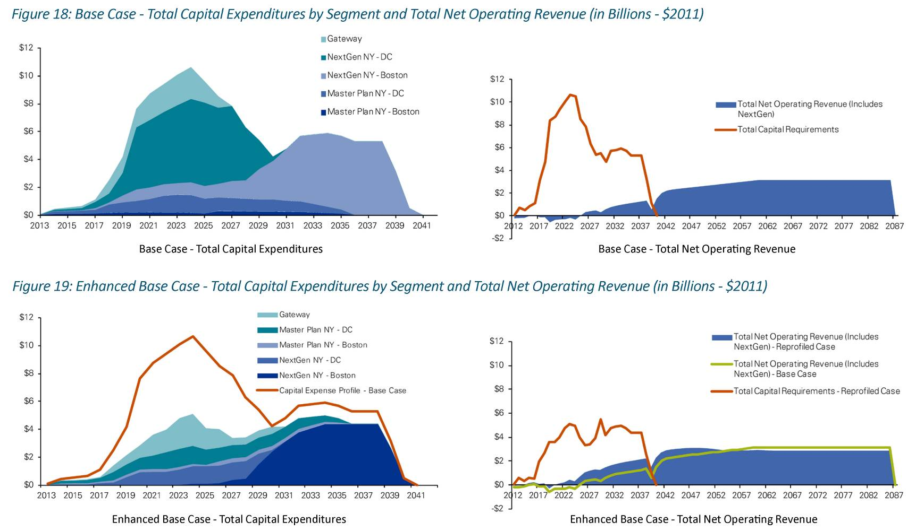
NEC Business & Financial Plan – Key Findings
Phasing and Integration of the Program is Critical – Plan identified options to phase Master Plan and Vision in order to create a realistic construction expenditure profile that reduces the annual outlay from the “base case”.
Base Case – Total Capital Expenditures by Segment and Total Net Operating Revenue (in Billions - $2011)
$5-$11B Average Annual Capex Rate
Enhanced Base Case – Total Capital Expenditures by Segment and Total Net Operating Revenue (in Billions - $2011)
$3-$5B Average Annual Capex Rate and Deferred Cost of $57B

Slide 24
Funding Availability
Significant funding is required to meet the capital needs of the program. Amtrak is exploring the following:
Access fees based on fully allocated costs
Passenger Rail Investment and Improvement Act (PRIIA) requires a standardized formula for determining and allocating costs, revenues, and compensation among all users of the NEC.
Additional Real Estate Opportunities
Yield Managed Fare Structure
State and Local Support

Slide 25
Business and Finance Plan Recommended Next Steps
Refine and develop program alternatives to match capital expenditures with revenue and funding
Coordinate with and support the FRA NEC FUTURE – PRCIP Program:
Share Business and Finance plan findings
Develop suggested high-level alternative to be evaluated
Complete PRIIA 212 cost sharing methodologies through the NEC Commission
Continue outreach with NEC stakeholders to build support and resources for the Program:
Administration and Congress
States and cities
Commuter and freight users
UIC and HST industry

Slide 26
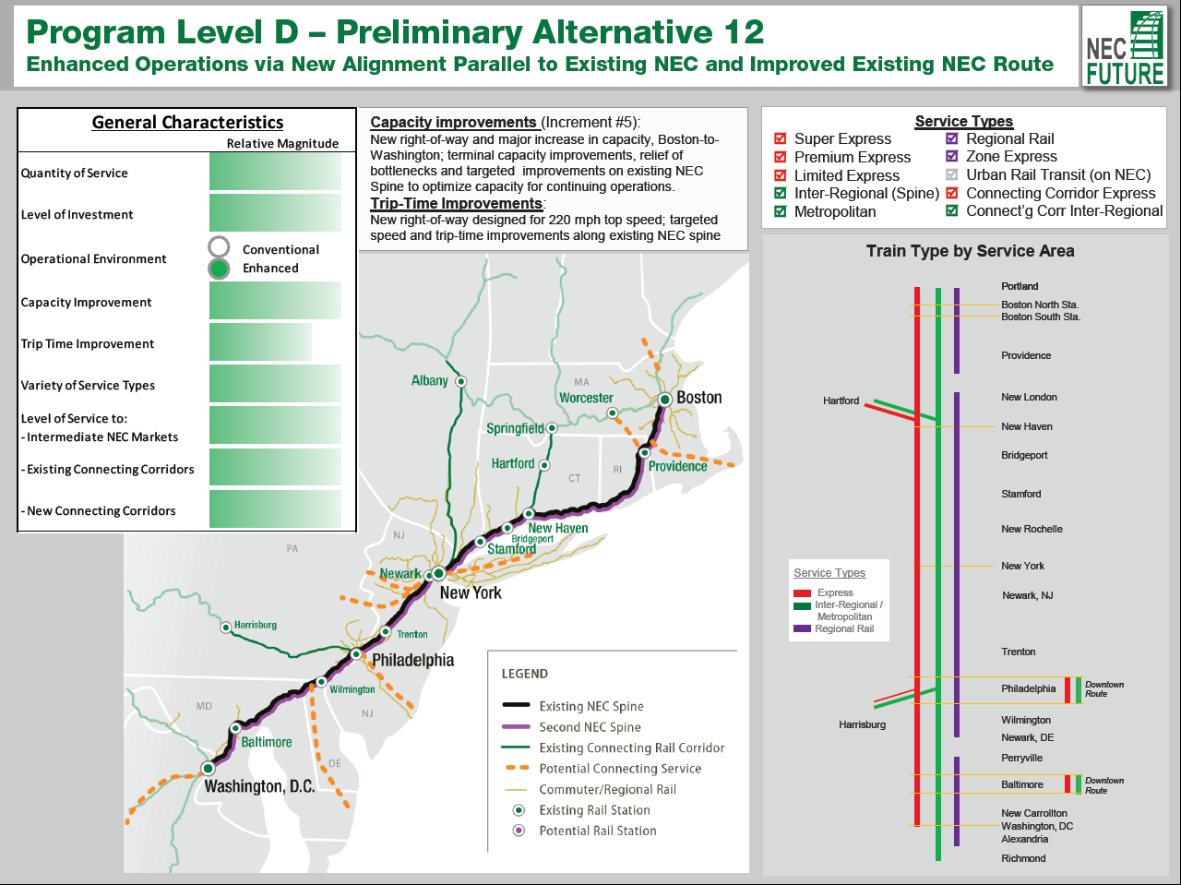
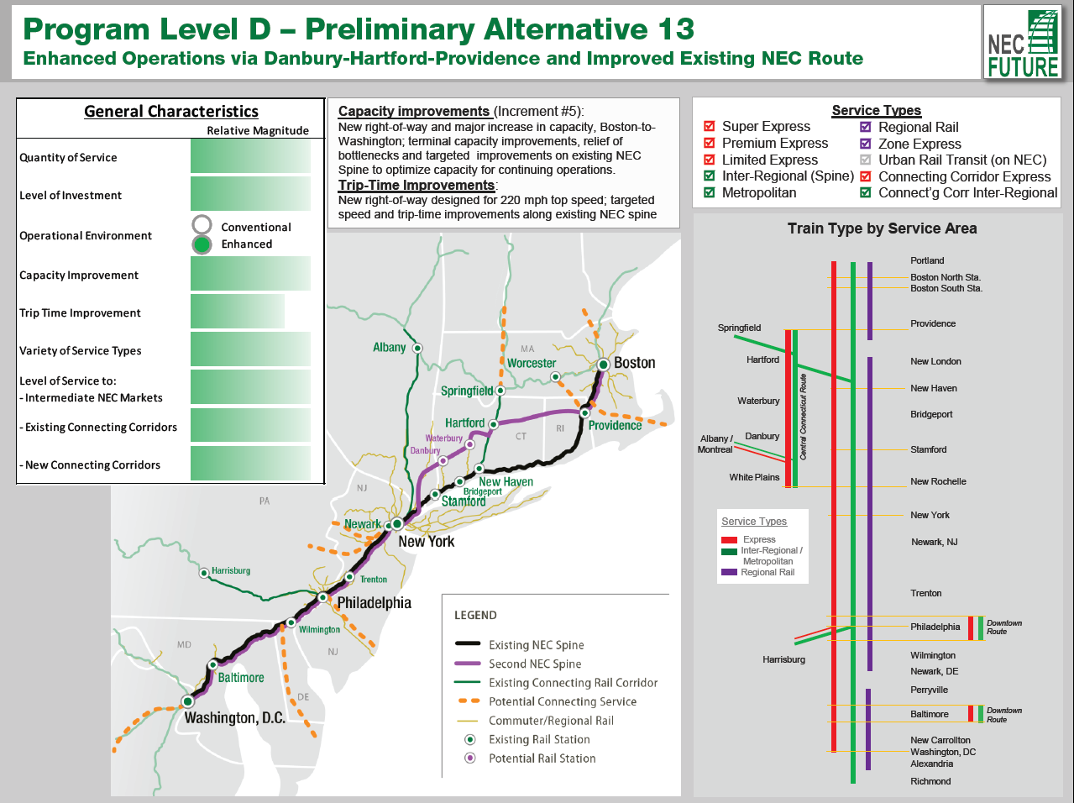
Preliminary Alternatives

Slide 27
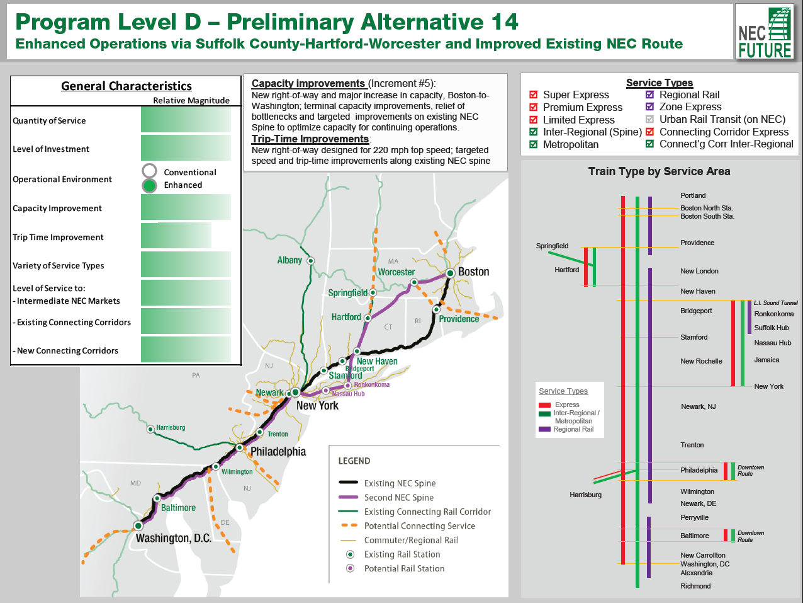
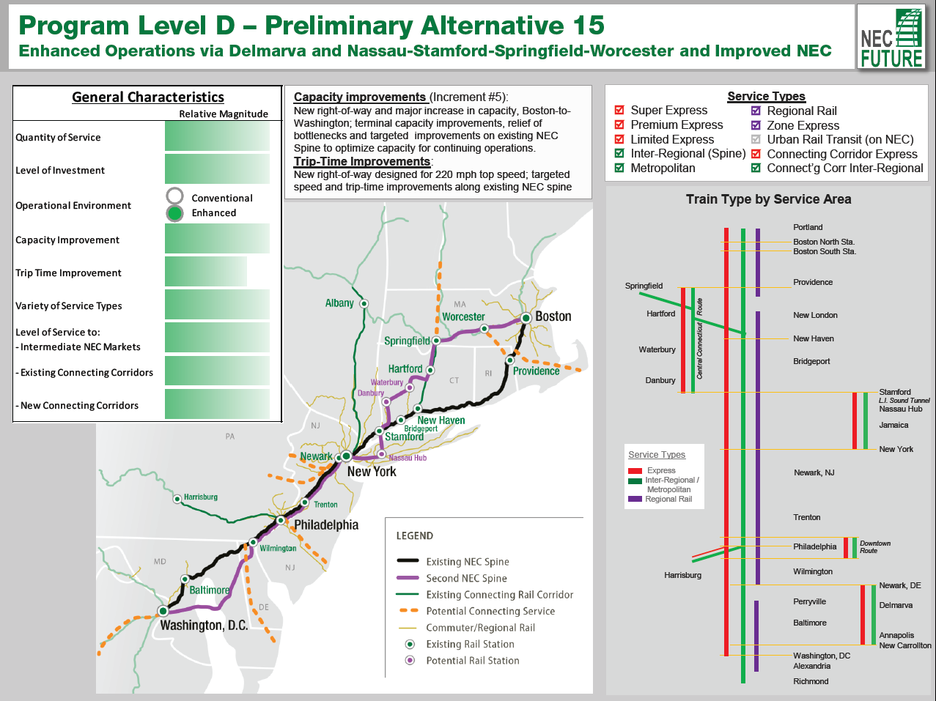
Preliminary Alternatives

Slide 28
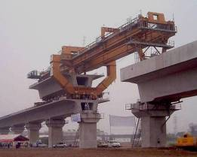
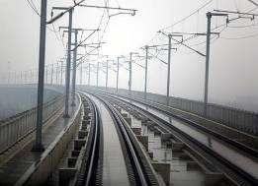
Moving Forward
Advance near-term planning with States, FRA and Northeast Corridor Advisory Commission
Coordination with Other Land Use and Transportation Plans
Private Sector Engagement
Advance Funding and Financing options
Initiate Near-Term Improvements
Notes:
28
28

Slide 29
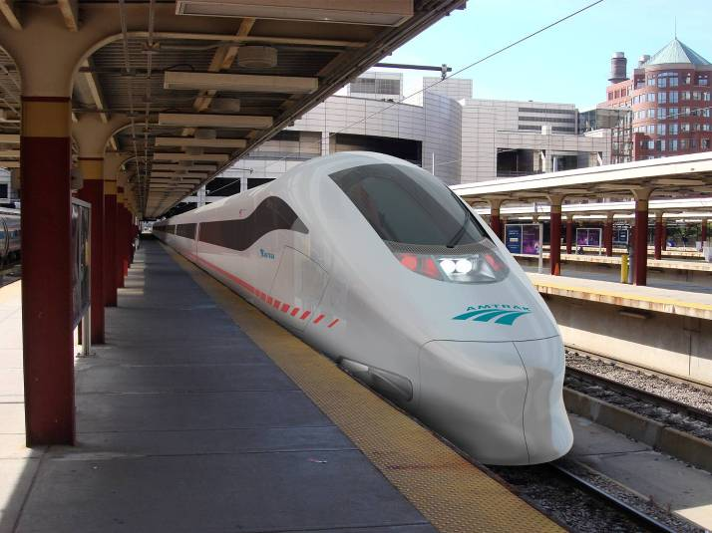
Thank You for Your Attention
andrew.wood@amtrak.com
WAS to PHL: 54 Minutes | PHL to NYC: 37Minutes | NYC to BOS: 94 Minutes

