Slide 1


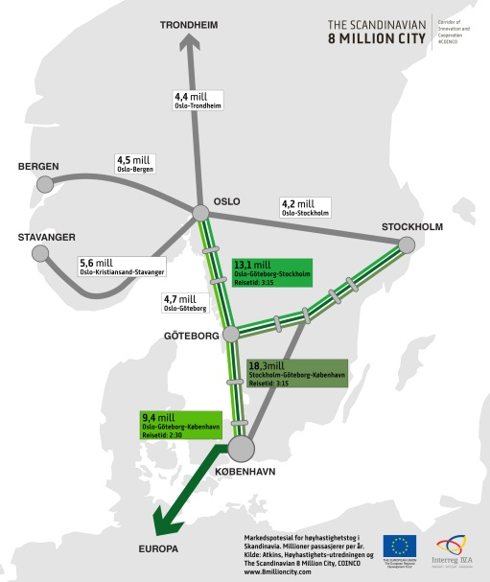
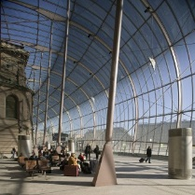

The railway station - Intermodal hub in the heart of the city (and region)
Andreas Heym
Architect Dipl.Ing. Senior Project Director
Director International Development
AREP Ville - Paris - France
« How to achieve a HSR network in Scandinavia » - Stockholm Conference - April 10th, 2013

Slide 2
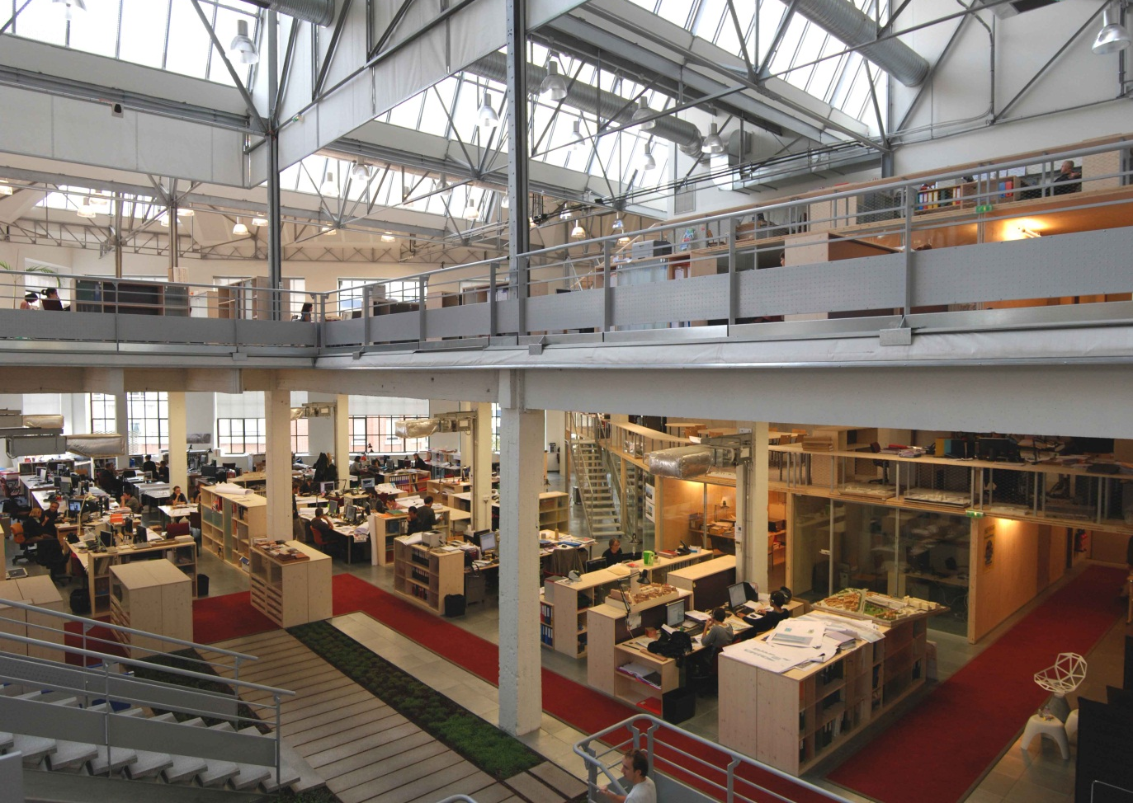
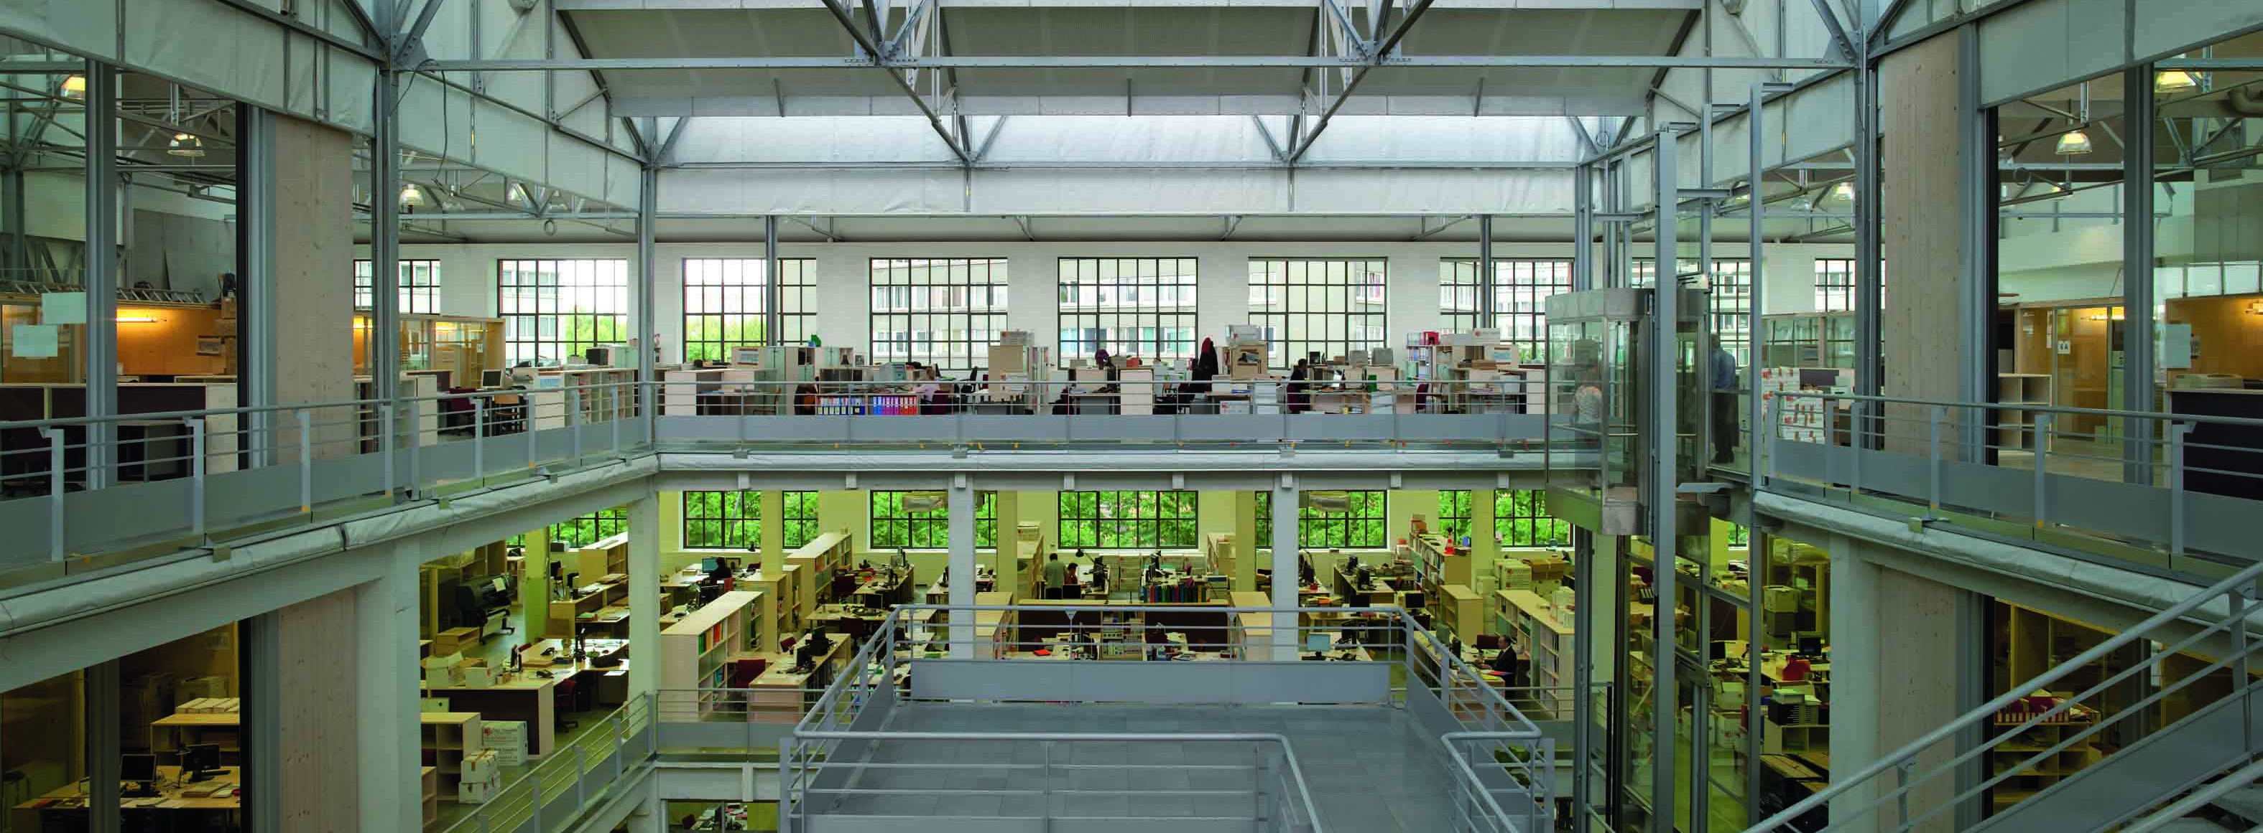
The company
AREP is a multidisciplinary architectural, urban development, engineering and consulting firm, with around 500 emplyoees from 20 nationalities.
AREP designs and builds worldwide, for state and local public authorities, railway companies, institutional investors as well as for private clients.
AREP is a 100% subsidiary of French Railways SNCF
and part of the SNCF Station Directorate Gares & Connexions.
AREP is based in Paris, with offices in Moscow, Beijing and Hanoi.
AREP’s turnover in 2012 was around 55 M€.
AREP is certified ISO 9001.

Slide 3
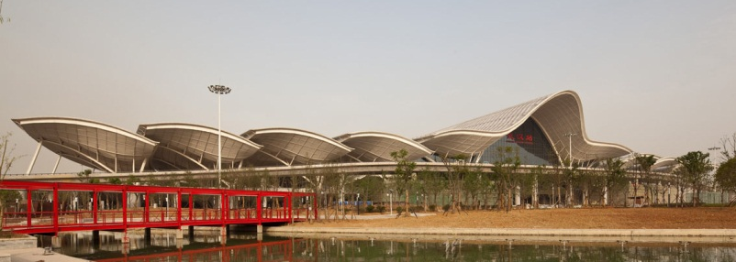
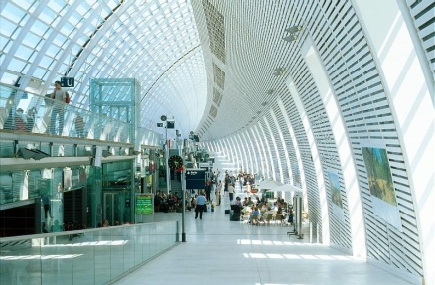
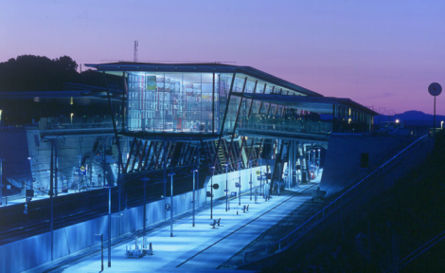
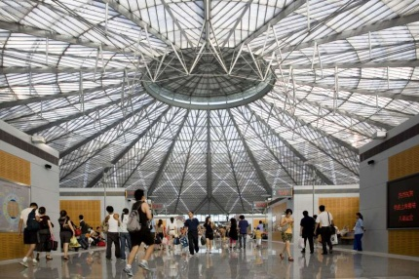
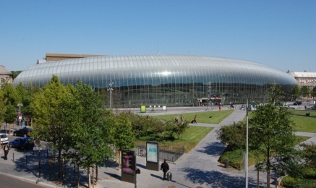

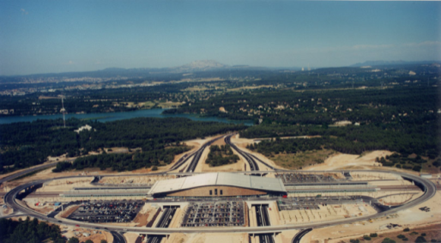
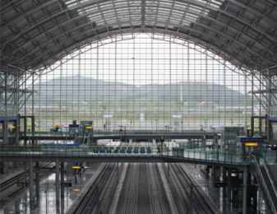
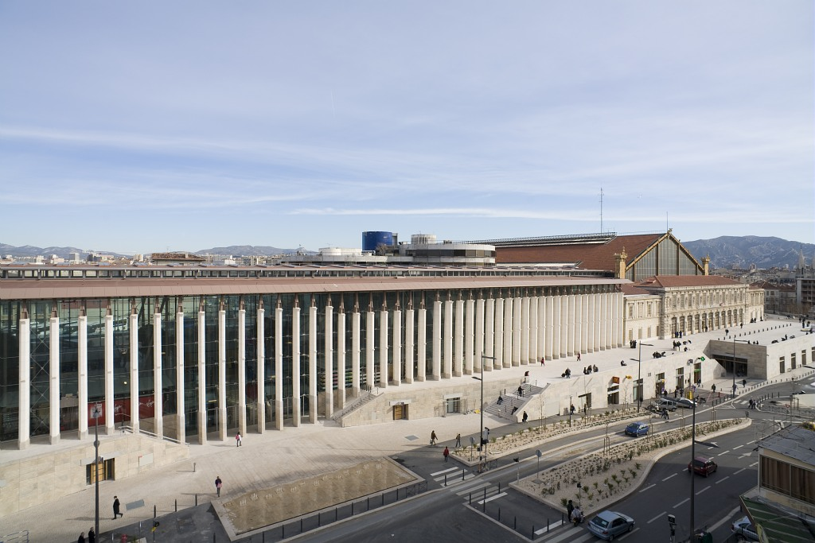
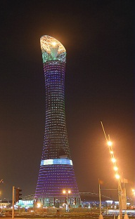
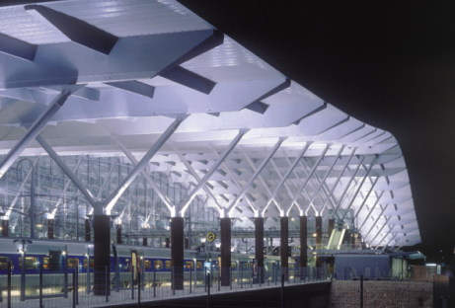
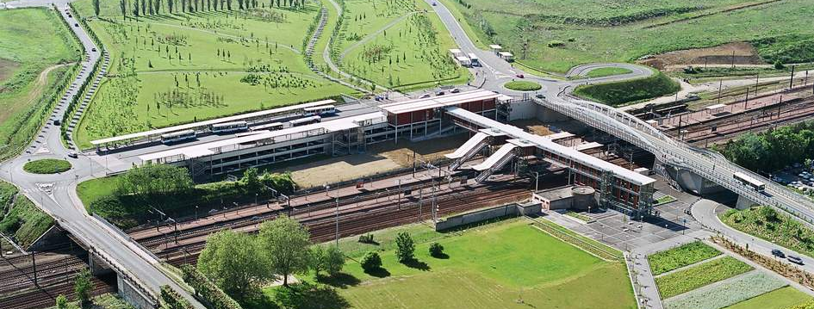
The company
Wuhan station, China
Avignon TGV station, France
Valence TGV station, France
Shanghai South station, China
Strasbourg station, France
City Museum, Beijing, China
Aix-en-Provence TGV station, France
Gwang Myeong station, Seoul
Marseille St Charles station, France
Sport City Tower Doha, Qatar
Aix-en-Provence TGV station, France
Lieusaint station, France

Slide 4
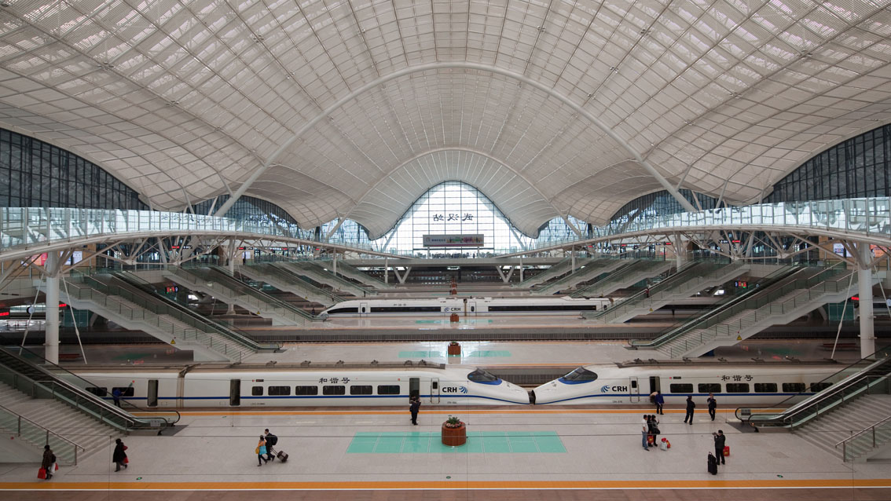
Wuhan HSR station, China

Slide 5
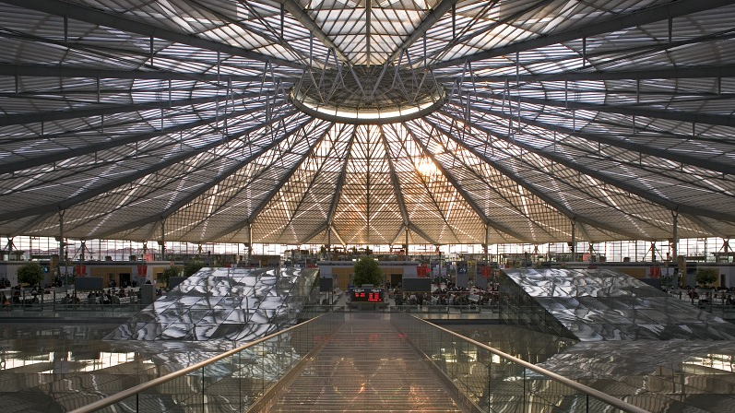
Shanghai South HSR station, China

Slide 6

Qing Dao HSR station, China (under construction)

Slide 7
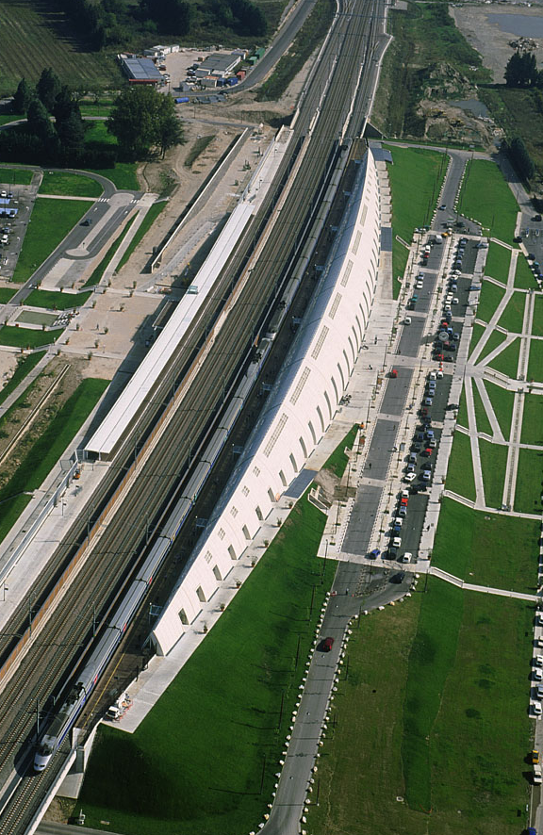
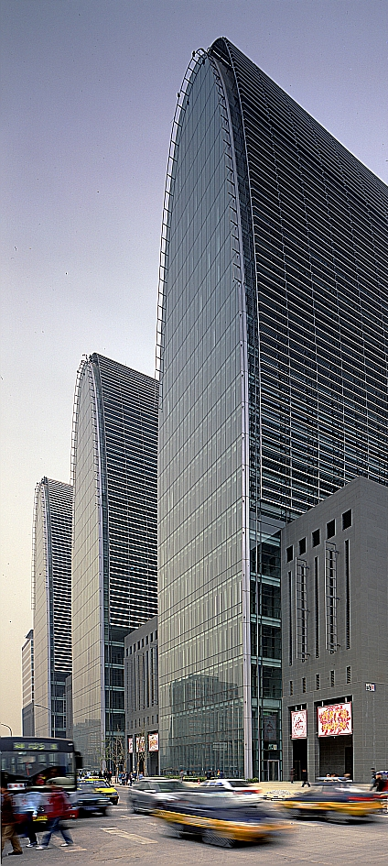

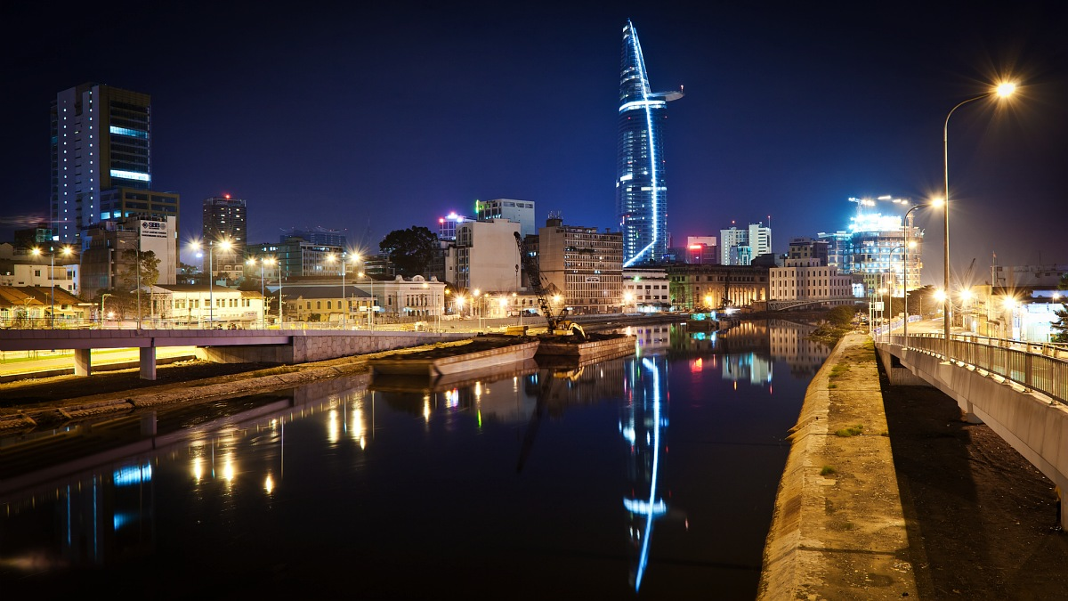
The company
Avignon TGV station, France
XiZhiMen station and CBD, Beijing, China
Avignon TGV station, France
Financial Tower, Ho-Chi-Minh City, Vietnam

Slide 8
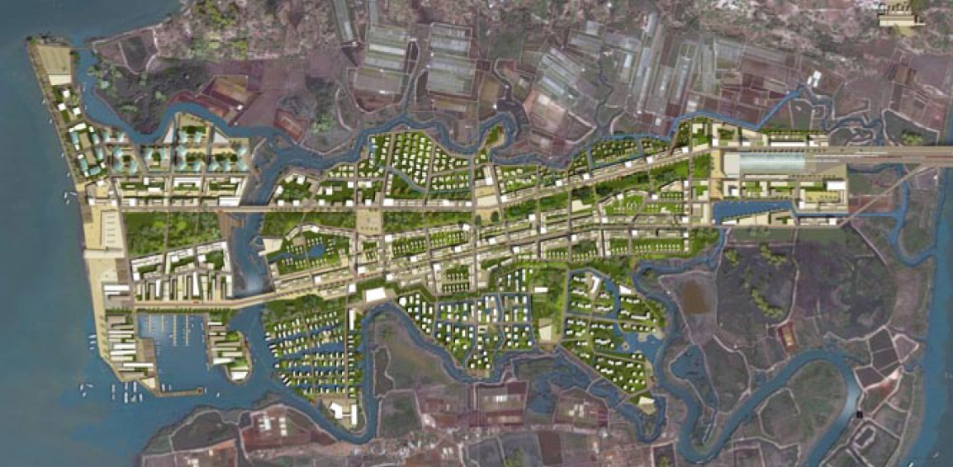
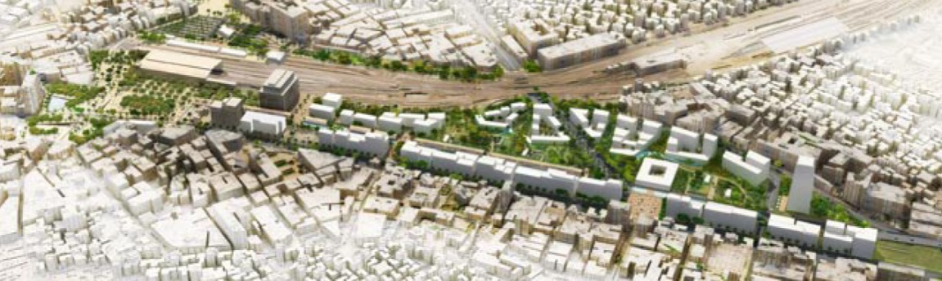
The company
Ving Tau urban development, Vietnam
Greater Paris Transport Development Scheme, France
Ramses II station square and urban development, Cairo, Egypt

Slide 9
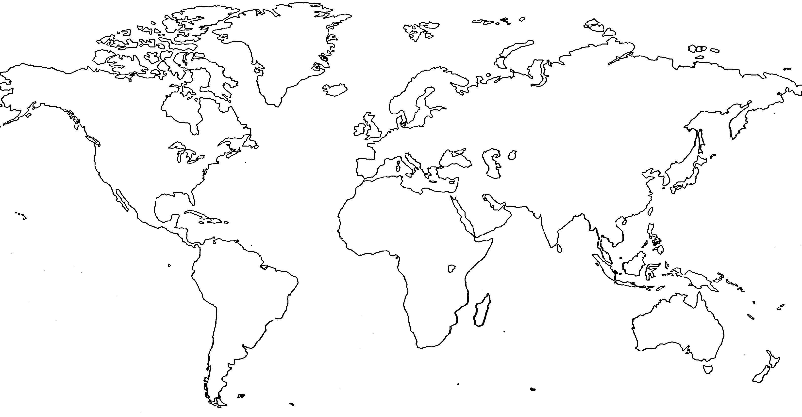
AREP has developed projects and consultancy in Europe, North America, North Africa, the Middle-East and Asia
St Petersburg
Tver
Ekaterinburg
Poznan
Moscow
Krasnoyarsk
Brussels
Lodz
Volgograd
Irkutsk
Khabarovsk
FRANCE
Lviv
Krasnodar
Torino
Budapest
Astrakhan
Beijing
Vladivostok
Athens
Sochi
San Francisco
Union City
Tanger
Tianjin
Seoul
Tokyo
Las Vegas
Fes
Oujda
Cairo
Dammam
Chengdu
Nanjing
Casablanca
Mekkah
Doha
Wuhan
Shanghai
Djeddah
Dubai
Hanoi
Shenzen
Mumbai
Ho-Chi-Minh City
Aceh

Slide 10
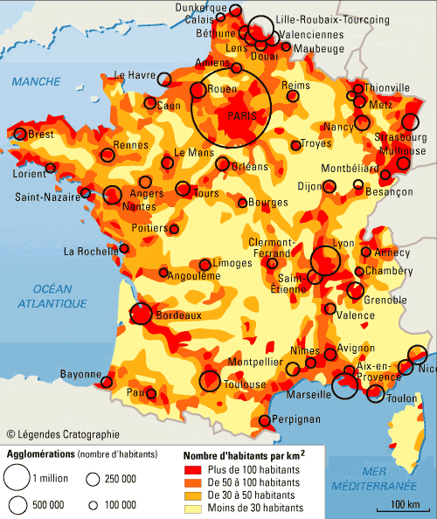
1993
2007
1994
1989/90
1981
2012
1994
2001
Population density and
evolution of the French TGV network
Source : SNCF Direction de l’Architecture

Slide 11
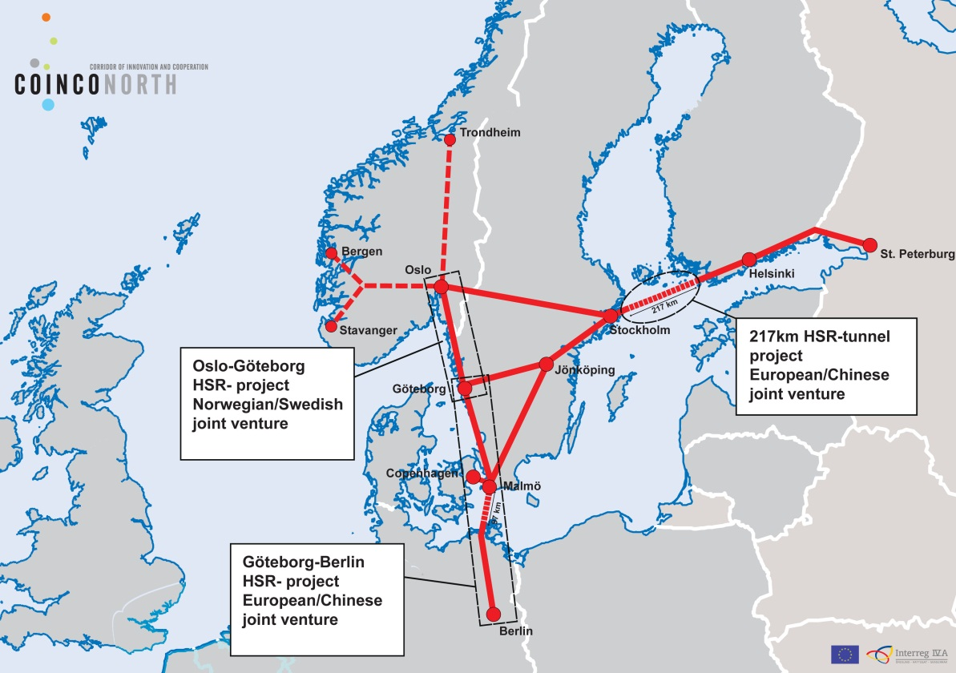
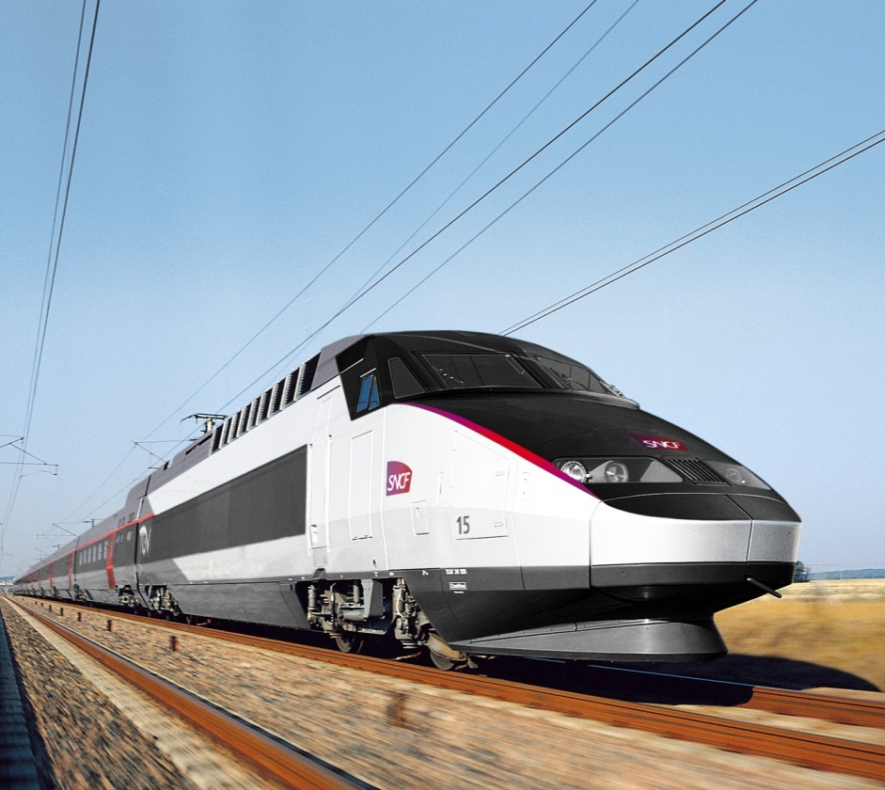

Slide 12
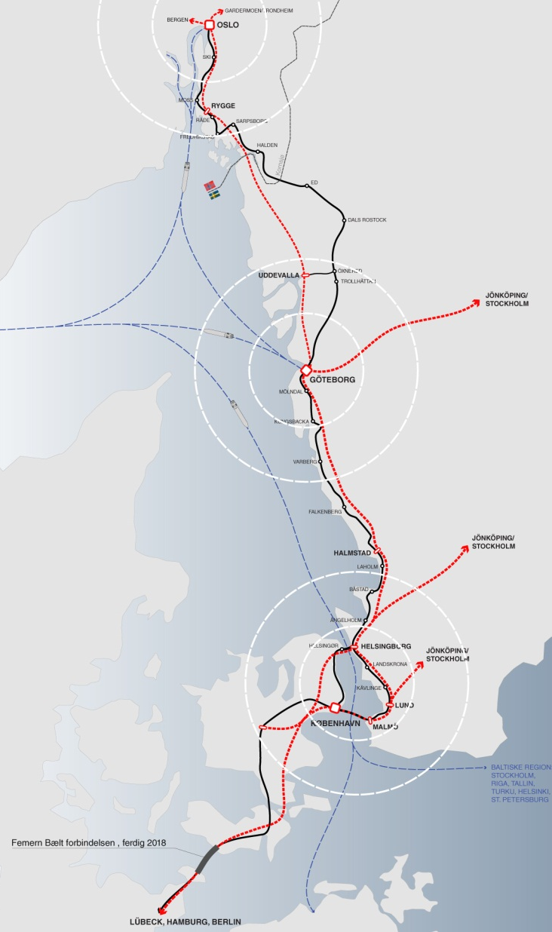
Big city terminus or through stations
Regional city stations
By-pass stations

Slide 13
Oslo
Rygge
Uddevalla
Stockholm
Norrköping
Linköping
Jönköping
Big city terminus or through stations
Regional city stations
By-pass stations
Boras
Göteborg
Halmstad
Helsingborg / Helsingør
Lund
Malmö
Copenhagen

Slide 14
Oslo
Rygge
Uddevalla
Stockholm
Norrköping
Linköping
Jönköping
Big city terminus or through stations
Regional city stations
By-pass stations
Boras
Göteborg
Halmstad
Helsingborg / Helsingør
Lund
Malmö
Copenhagen

Slide 15
Capacity & track geometry & operations & public acceptance & money => where and how to put the station ?
Accessibility & intermodality => how to get there and back ?
Mobility & development => how to live in the city of tomorrow ?

Slide 16
1993
2007
1994
1989/90
Lille-Europe station, France
1981
2012
1994
2001

Slide 17
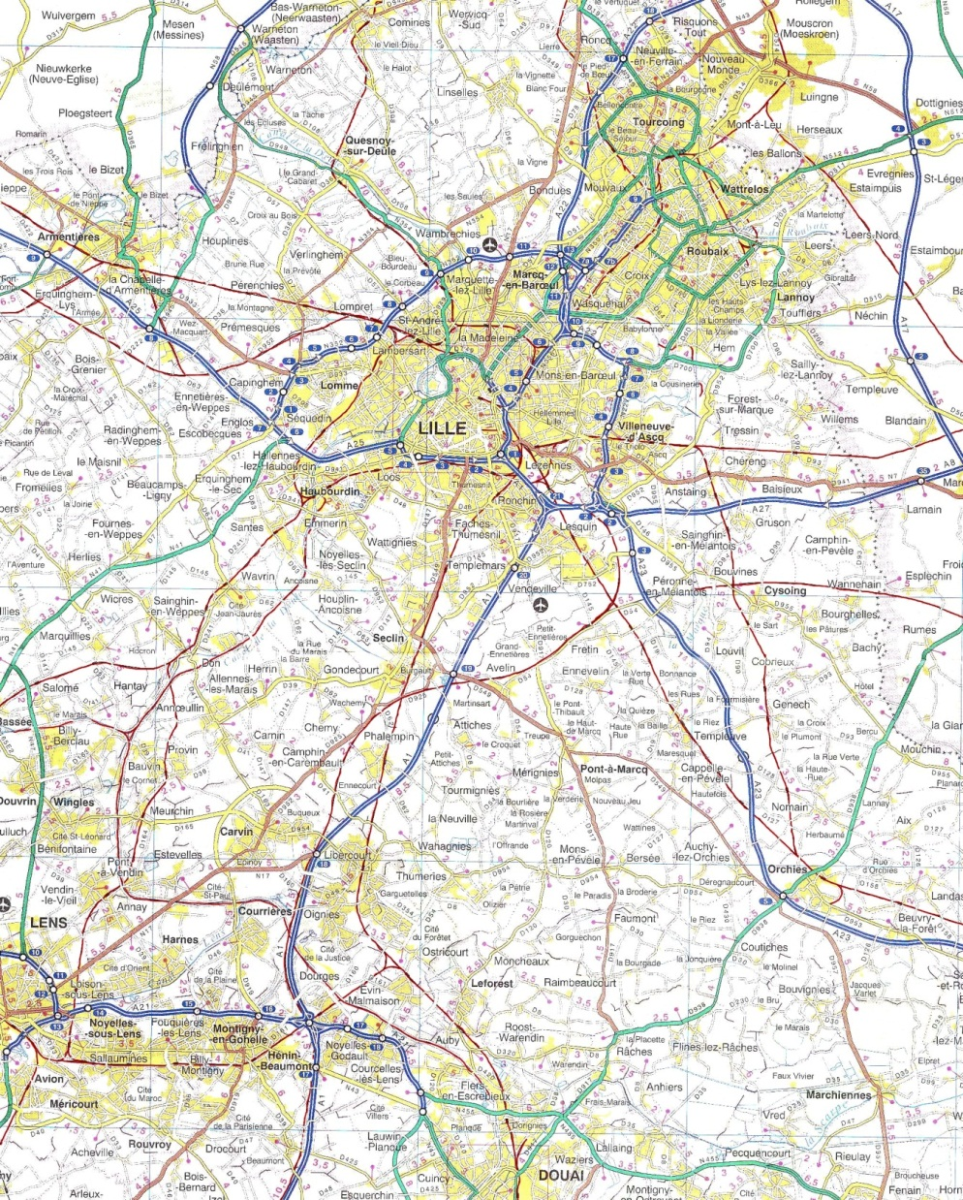
Lille-Europe

Slide 18
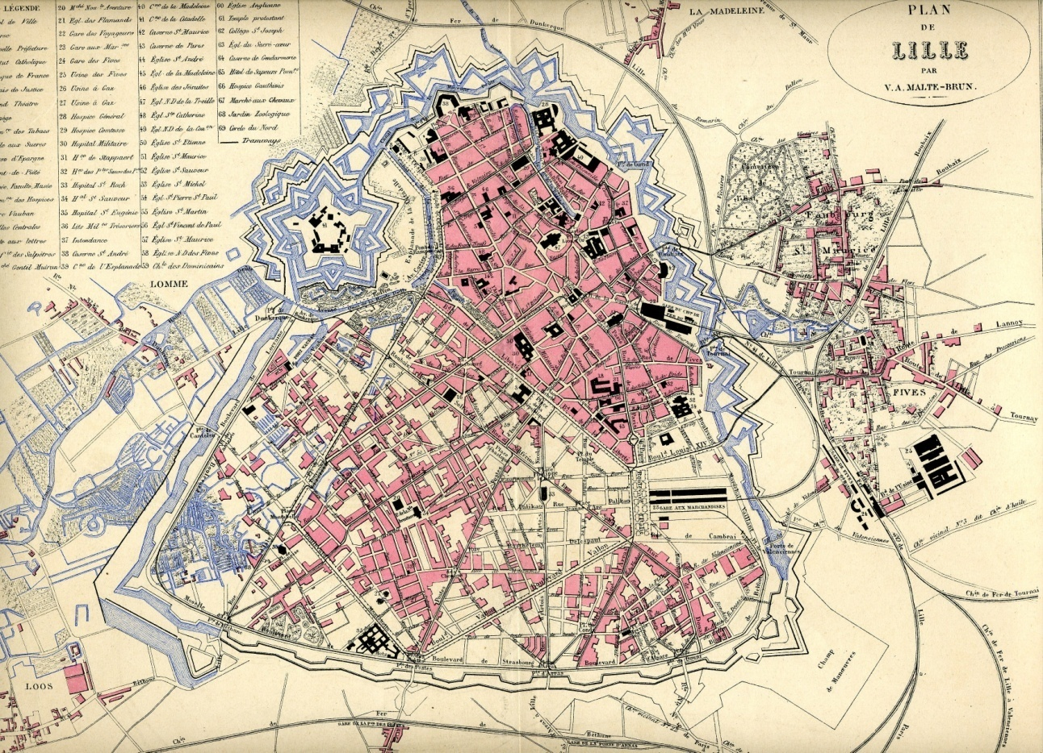
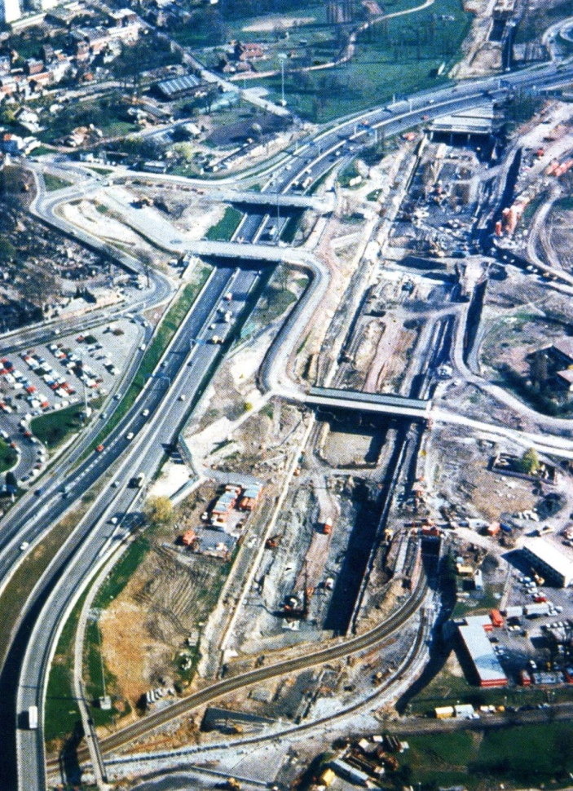
Lille-Europe

Slide 19
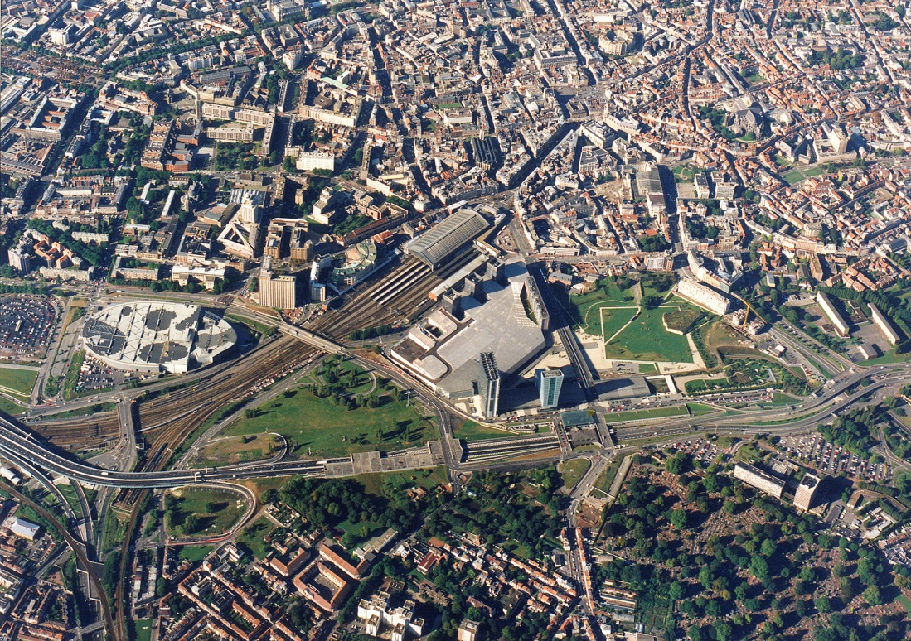
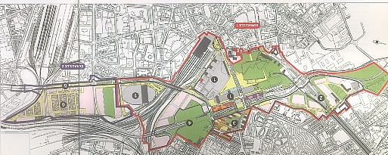
Lille-Europe

Slide 20
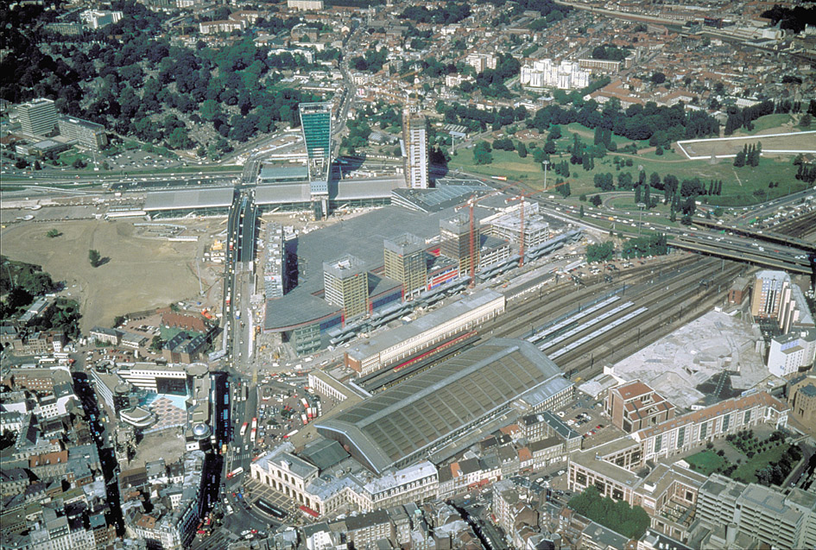
Lille-Europe

Slide 21
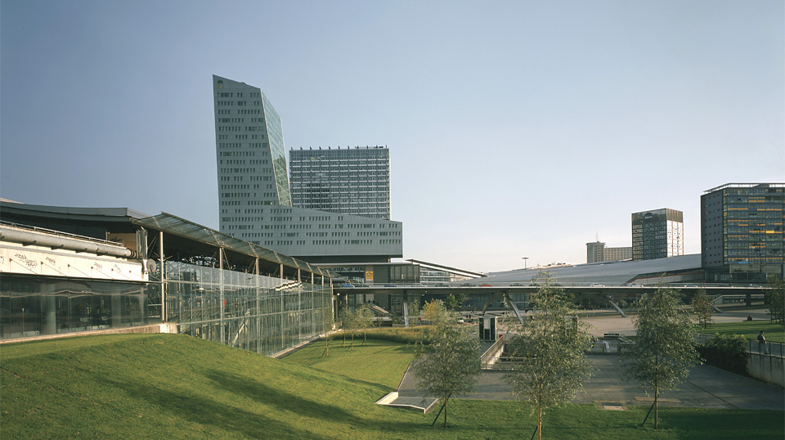
Lille-Europe

Slide 22
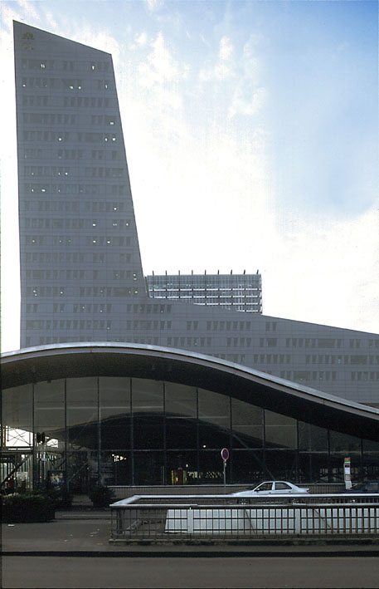
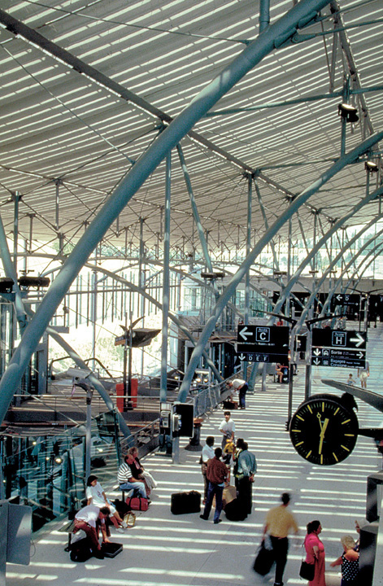
Lille-Europe

Slide 23
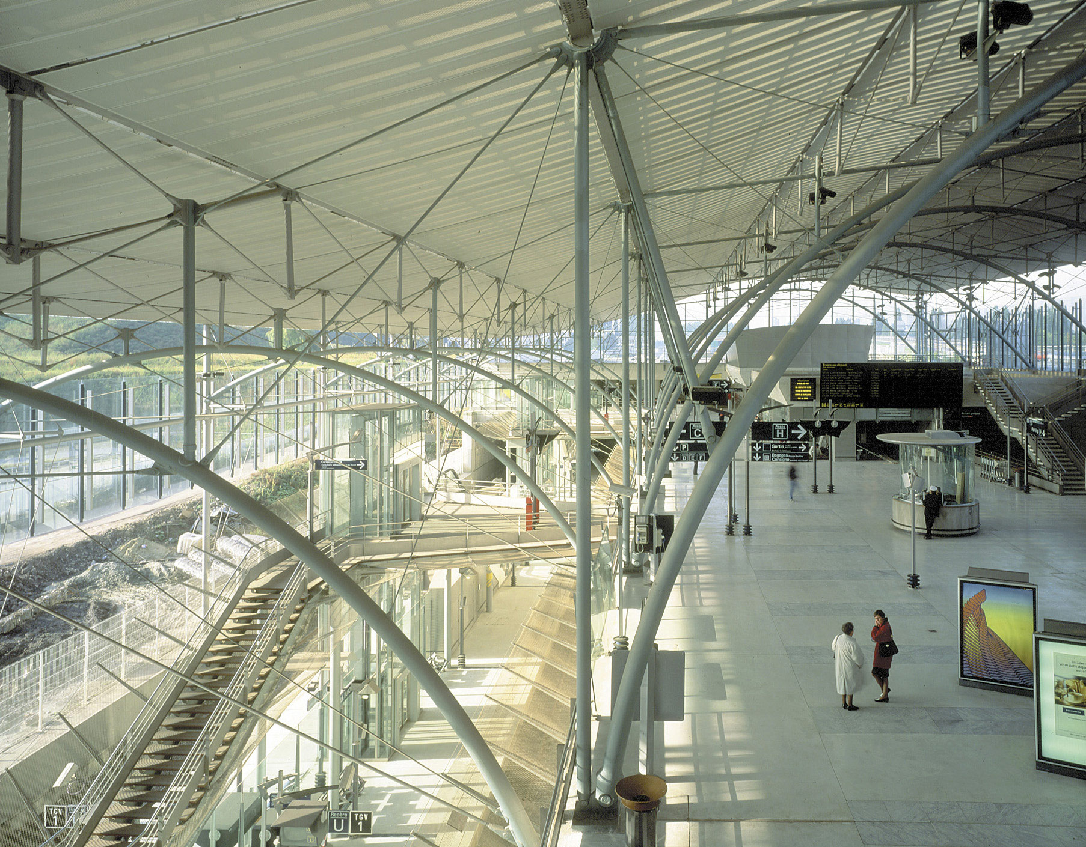
Lille-Europe

Slide 24
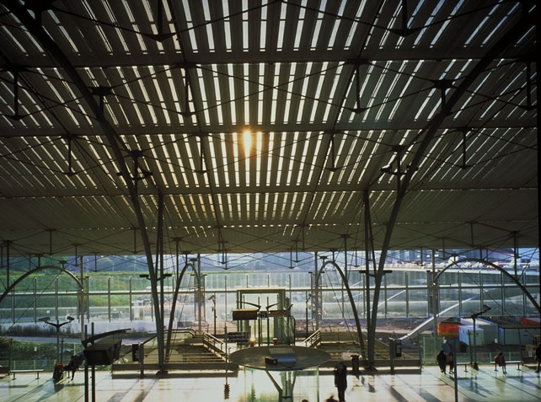
Lille-Europe

Slide 25
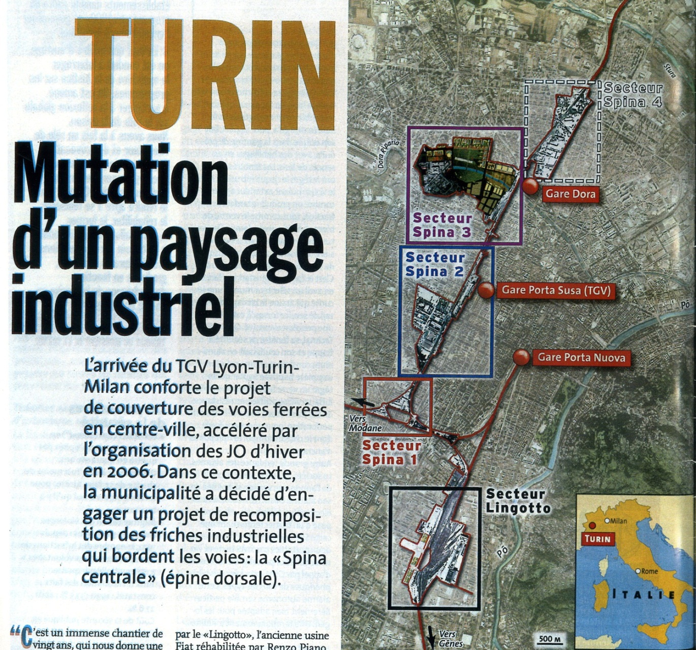
Torino Porta Susa station, Italy

Slide 26
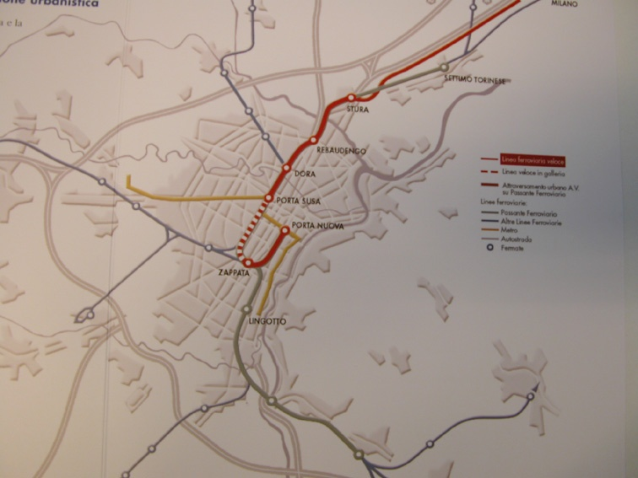
Torino Porta Susa

Slide 27
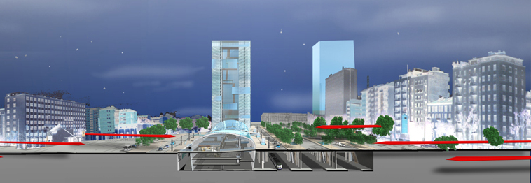
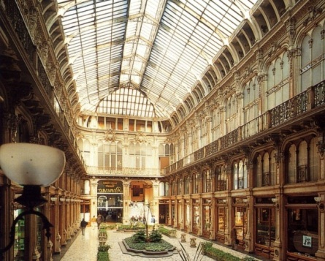
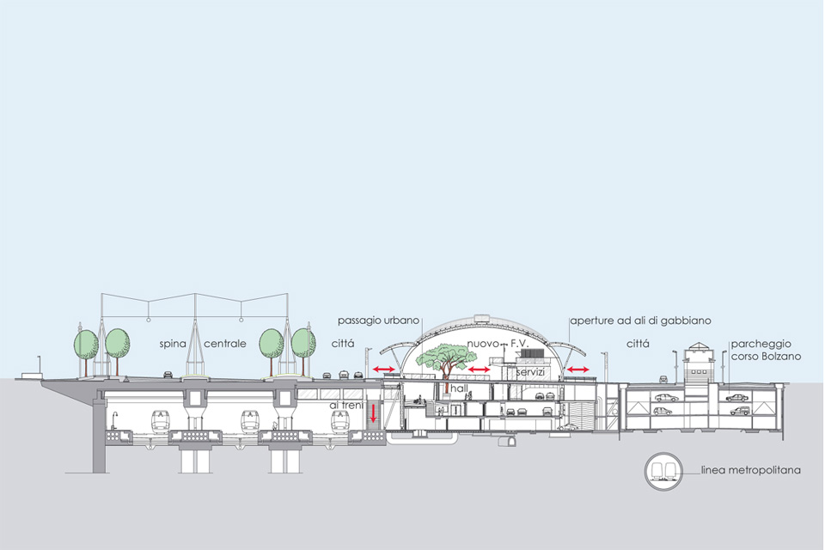
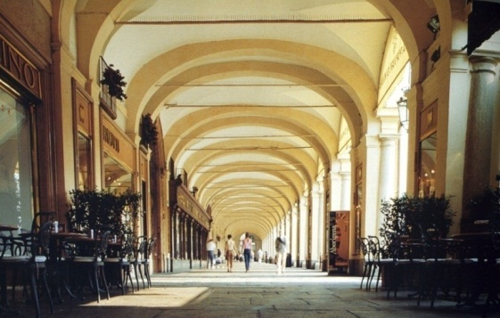
Torino Porta Susa

Slide 28
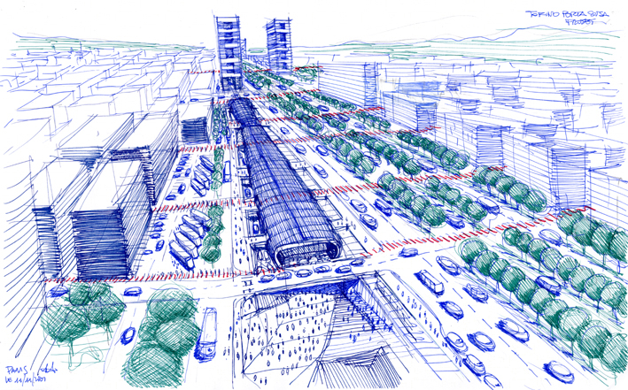
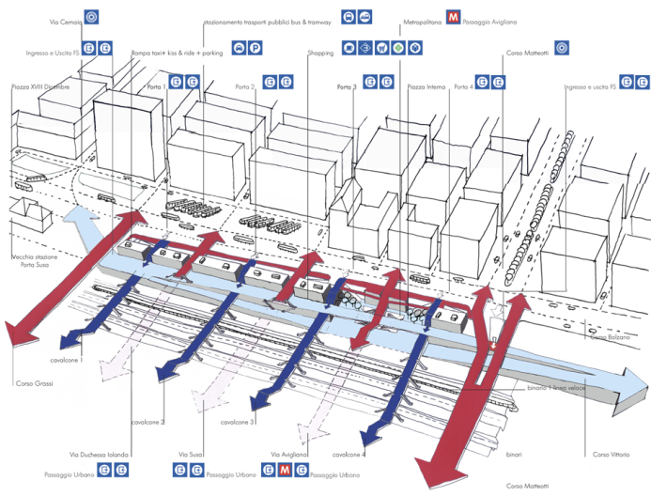
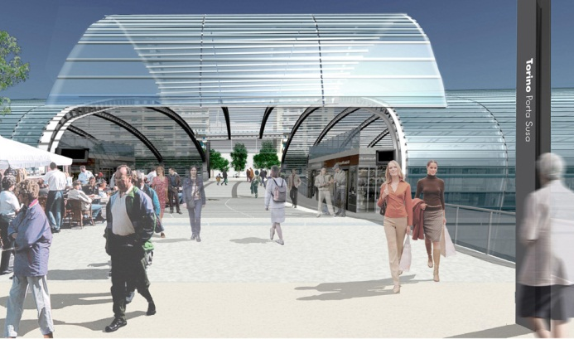
Torino Porta Susa

Slide 29
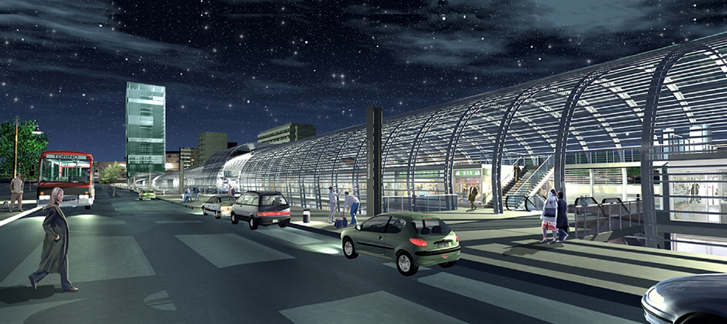
Torino Porta Susa

Slide 30
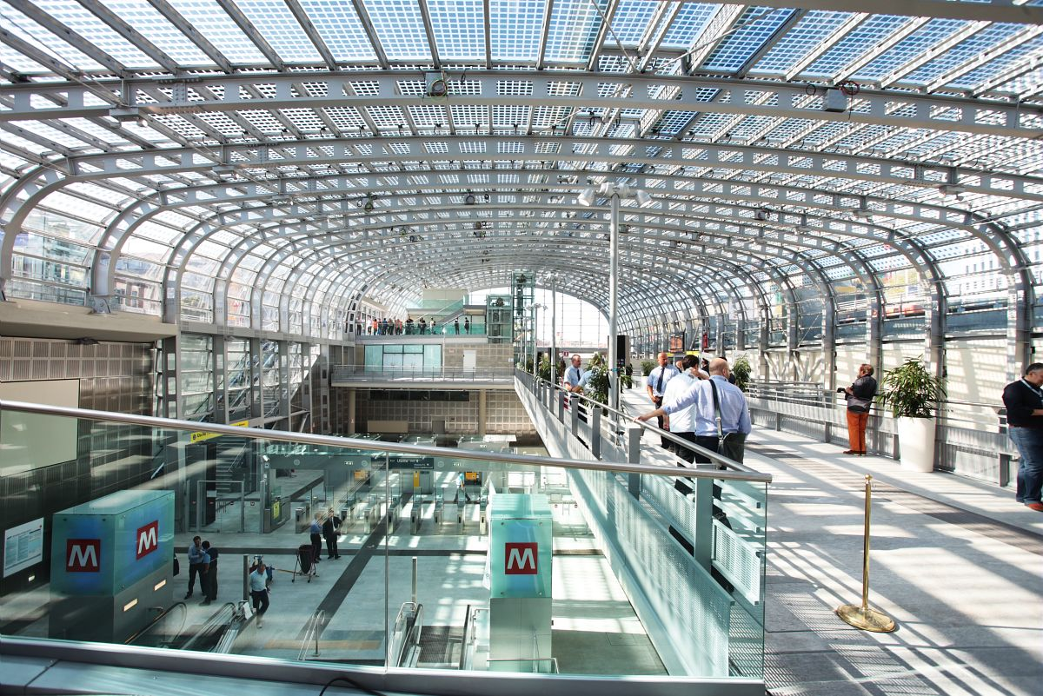
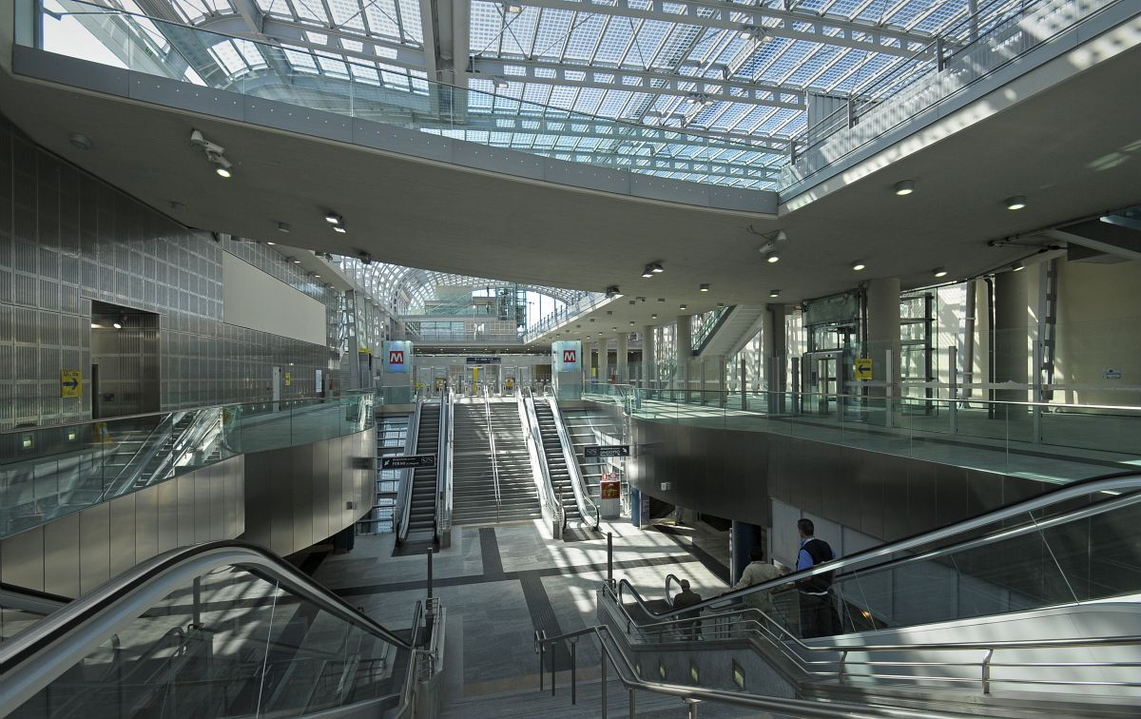


Torino Porta Susa

Slide 31

Torino Porta Susa

Slide 32

Torino Porta Susa

Slide 33
1993
2007
1994
1989/90
Marseille St Charles station, France
1981
2012
1994
2001

Slide 34

Marseille St Charles

Slide 35

Marseille St Charles

Slide 36




Marseille St Charles

Slide 37

Marseille St Charles

Slide 38
Marseille St Charles

Slide 39

Marseille St Charles

Slide 40

Marseille St Charles

Slide 41

Marseille St Charles

Slide 42
1993
2007
1994
1989/90
Strasbourg station, France
1981
2012
1994
2001

Slide 43






Strasbourg

Slide 44



Strasbourg

Slide 45




Strasbourg

Slide 46

Strasbourg

Slide 47
Oslo
Rygge
Uddevalla
Stockholm
Norrköping
Linköping
Jönköping
Big city terminus or through stations
Regional city stations
By-pass stations
Boras
Göteborg
Halmstad
Helsingborg / Helsingør
Lund
Malmö
Copenhagen

Slide 48
1993
2007
1994
1989/90
Angers St Laud station, France
1981
2012
1994
2001

Slide 49


Angers St Laud

Slide 50

Angers St Laud

Slide 51

Angers St Laud

Slide 52

Angers St Laud

Slide 53
1993
2007
1994
1989/90
Le Mans station, France
1981
2012
1994
2001

Slide 54





Le Mans

Slide 55




Le Mans

Slide 56


Le Mans

Slide 57




Le Mans

Slide 58

Le Mans

Slide 59
Oslo
Rygge
Uddevalla
Stockholm
Norrköping
Linköping
Jönköping
Big city terminus or through stations
Regional city stations
By-pass stations
Boras
Göteborg
Halmstad
Helsingborg / Helsingør
Lund
Malmö
Copenhagen

Slide 60
1993
2007
1994
1989/90
Avignon TGV station, France
1981
2012
1994
2001

Slide 61

Avignon TGV

Slide 62
Avignon TGV

Slide 63


Avignon TGV

Slide 64


Avignon TGV

Slide 65
1993
2007
1994
1989/90
Valence TGV station, France
1981
2012
1994
2001
Source : SNCF Direction de l’Architecture

Slide 66

Valence TGV

Slide 67

Valence TGV

Slide 68

Valence TGV

Slide 69


Valence TGV

Slide 70

Valence TGV

Slide 71

Valence TGV

Slide 72
1993
2007
1994
1989/90
Aix-en-Provence TGV station, France
1981
2012
1994
2001

Slide 73

Aix-en-Provence TGV

Slide 74

Aix-en-Provence TGV

Slide 75




Aix-en-Provence TGV

Slide 76
1993
2007
1994
1989/90
Belfort-Montbéliard TGV station, France
1981
2012
1994
2001

Slide 77

Belfort - Montbéliard TGV

Slide 78

Belfort - Montbéliard TGV

Slide 79

Belfort - Montbéliard TGV

Slide 80

Belfort - Montbéliard TGV

Slide 81

Belfort - Montbéliard TGV

Slide 82



Belfort - Montbéliard TGV

Slide 83



Belfort - Montbéliard TGV

Slide 84
1993
2007
1994
1989/90
Meuse TGV station, France
1981
2012
1994
2001

Slide 85



Meuse TGV

Slide 86
1993
2007
1994
1989/90
Champagne-Ardenne TGV station & Reims-Bezannes urban development, France
1981
2012
1994
2001

Slide 87

Champagne-Ardenne TGV

Slide 88

Champagne-Ardenne TGV / Reims-Bezannes urban development

Slide 89

Champagne-Ardenne TGV / Reims-Bezannes urban development

Slide 90

Champagne-Ardenne TGV / Reims-Bezannes urban development

Slide 91


Champagne-Ardenne TGV / Reims-Bezannes urban development

Slide 92

Champagne-Ardenne TGV / Reims-Bezannes urban development

Slide 93

Champagne-Ardenne TGV / Reims-Bezannes urban development

Slide 94
First conclusions
Whatever their scale, high-speed rail station projects are urban projects, inked to the constraints of the rail infrastructure
They are always part of larger development and transport schemes, combining local, regional, even national scales
HSR station design is part of the overall system design.
HSR stations are major intermodal hubs. As such, they are by definition complex multi-partner and multi-operator projects, involving multiple financing and multiple stake holders throughout all planning stages
Therefore, the design process must be iterative, many program elements will appear only over time
HSR station design goes beyond simple building design : it is more appropriate to call it « interior urbanism » and manage it accordingly
Stations are parts of the city, they are places to live. So they should have a sense of place, be attractive, nice and fun !

Slide 95

Yes we are ready to participate in the the design of the 21st century Scandinavian HSR station !

Slide 96
www.arep.fr
Contact :
Andreas Heym
16, Avenue d’Ivry 75647 Paris Cedex 13 - France Tel + 33 1 57 27 19 13 Fax + 33 1 57 27 19 01 Mob + 33 6 09 18 34 23
andreas.heym@arep.fr
AREP is a 100% subsidiary of French Railways

